Slide 1

KICKSTARTER Understanding Crowdfunding Through Data
DATE : 19th July 2025
Presentation by
Mohd Burhan Uddin

Slide 2

INTRODUCTION
What is Kickstarter?
Kickstarter is a crowdfunding platform that helps creators raise funds for creative projects across categories like art, technology, design, film, games, and music. Launched in 2009, it operates on an all-or-nothing funding model, where projects only receive funds if they meet or exceed their goal.

Slide 3
Why Kickstarter is Interesting to Data Analysts
Rich historical data
Structured and unstructured data (numeric + text)
Available datasets
Real-world predictive modeling use case

Slide 4
Key Metrics to Analyze.
Funding Goal vs. Pledged Amount
Number of Backers
Project Duration
Project Duration
Success/Failure Rate
Category Trends
Launch Dates and Deadlines

Slide 5
Potential Analysis Questions.
What factors affect project success?
Which categories perform best?
Is there a pattern in successful project durations?
What pledge goal is optimal for certain categories?

Slide 6
Example Tools & Techniques.
Data Cleaning: EXCEL
Visualization: EXCEL/Power BI / Tableau
Modeling: EXCEL / Power BI Desktop / Tableau Desktop
Text Analysis: SQL

Slide 7
1.Data Cleaning By Excel

Slide 8
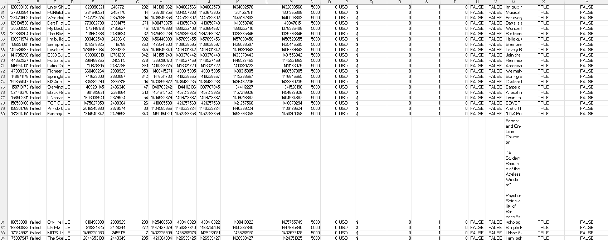
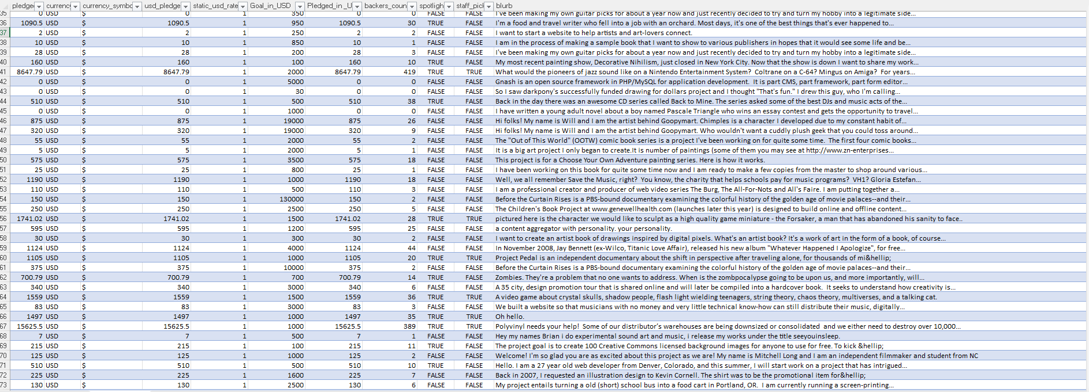

Slide 9
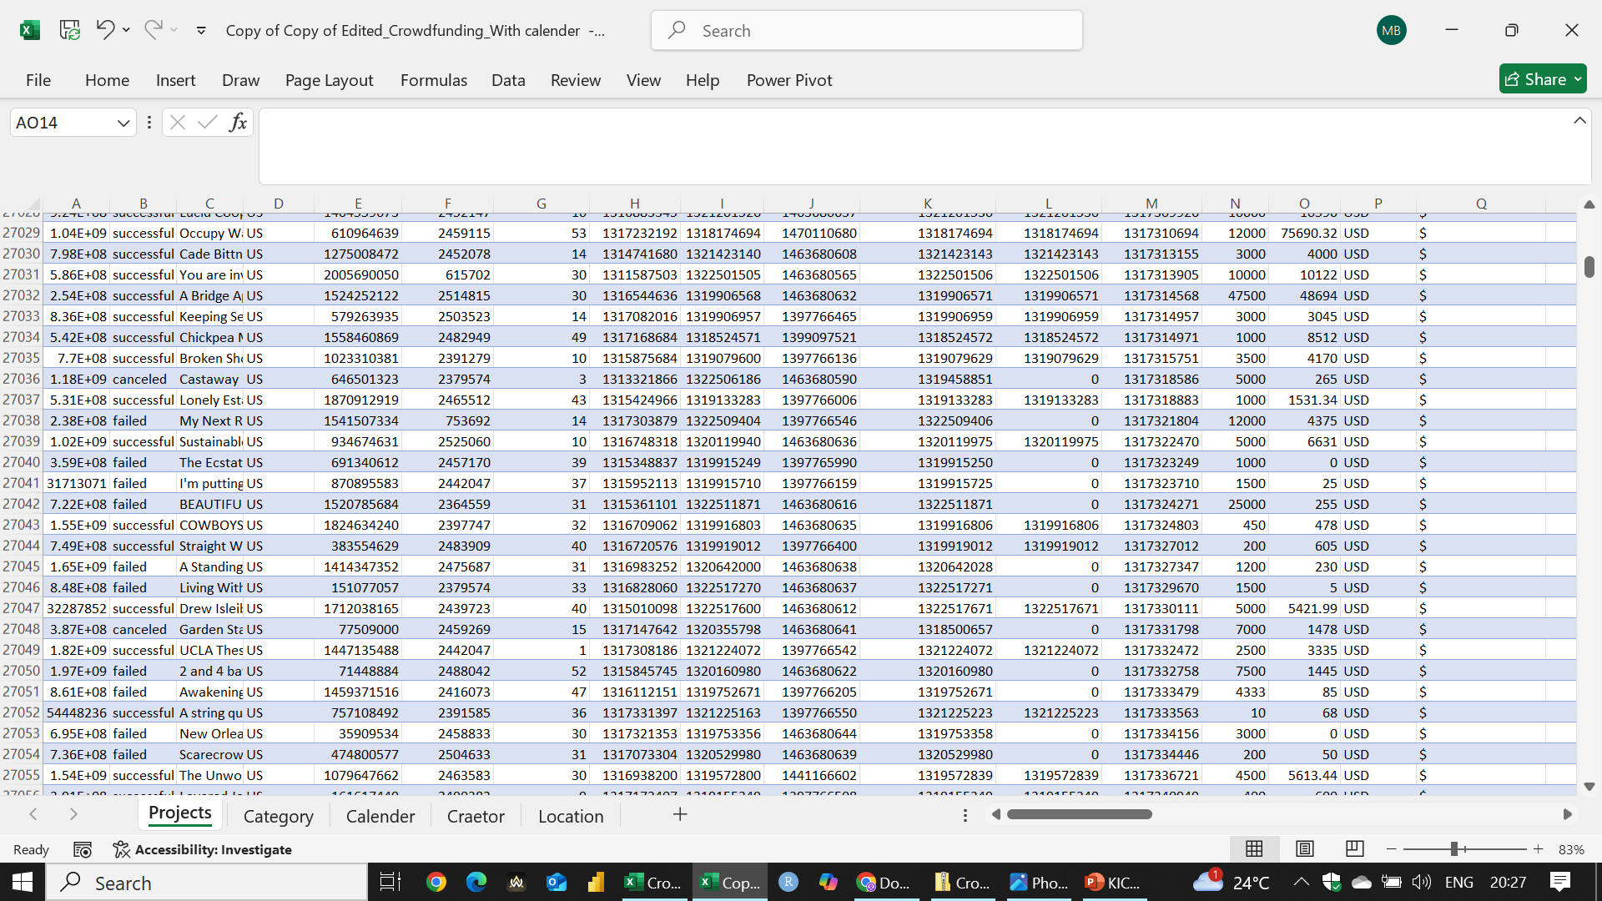

Slide 10
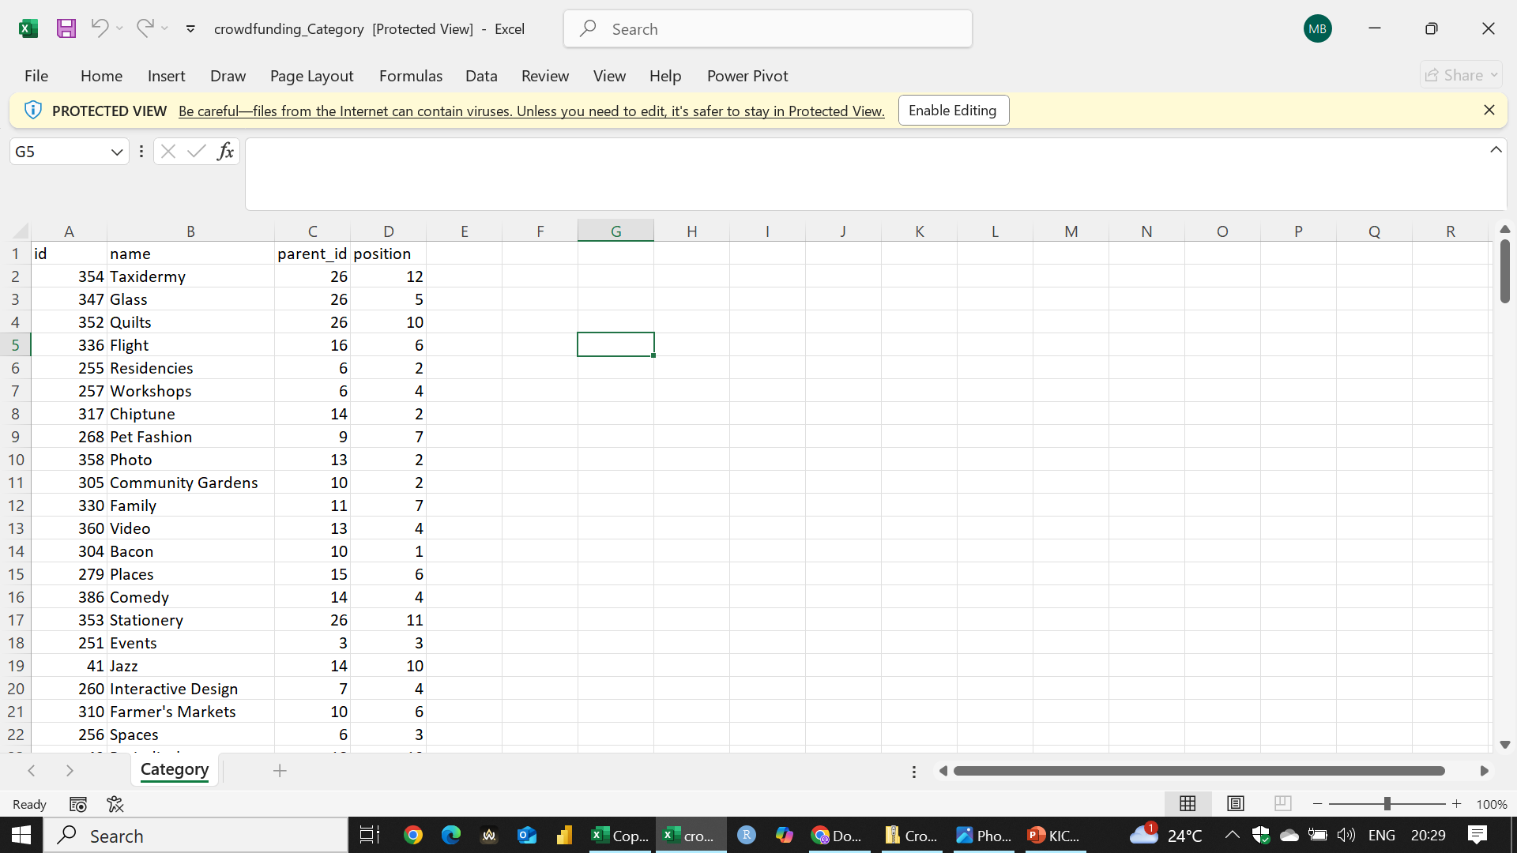
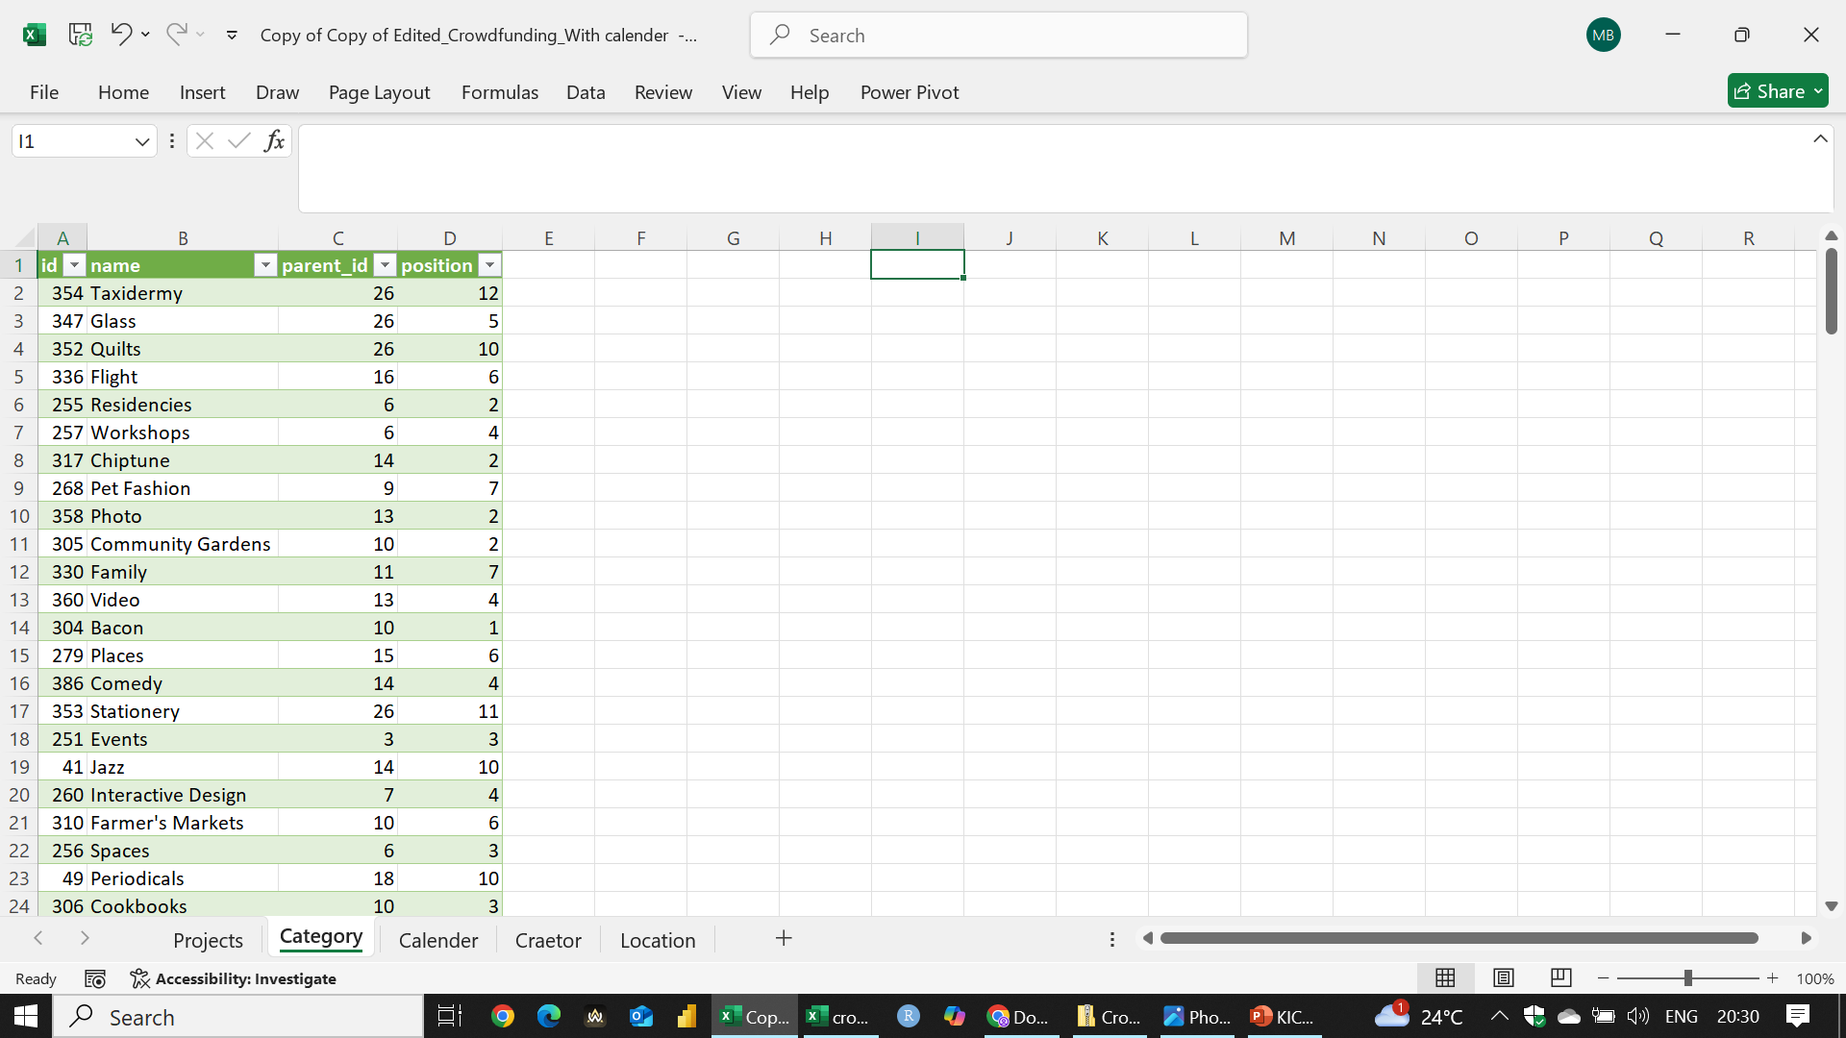

Slide 11
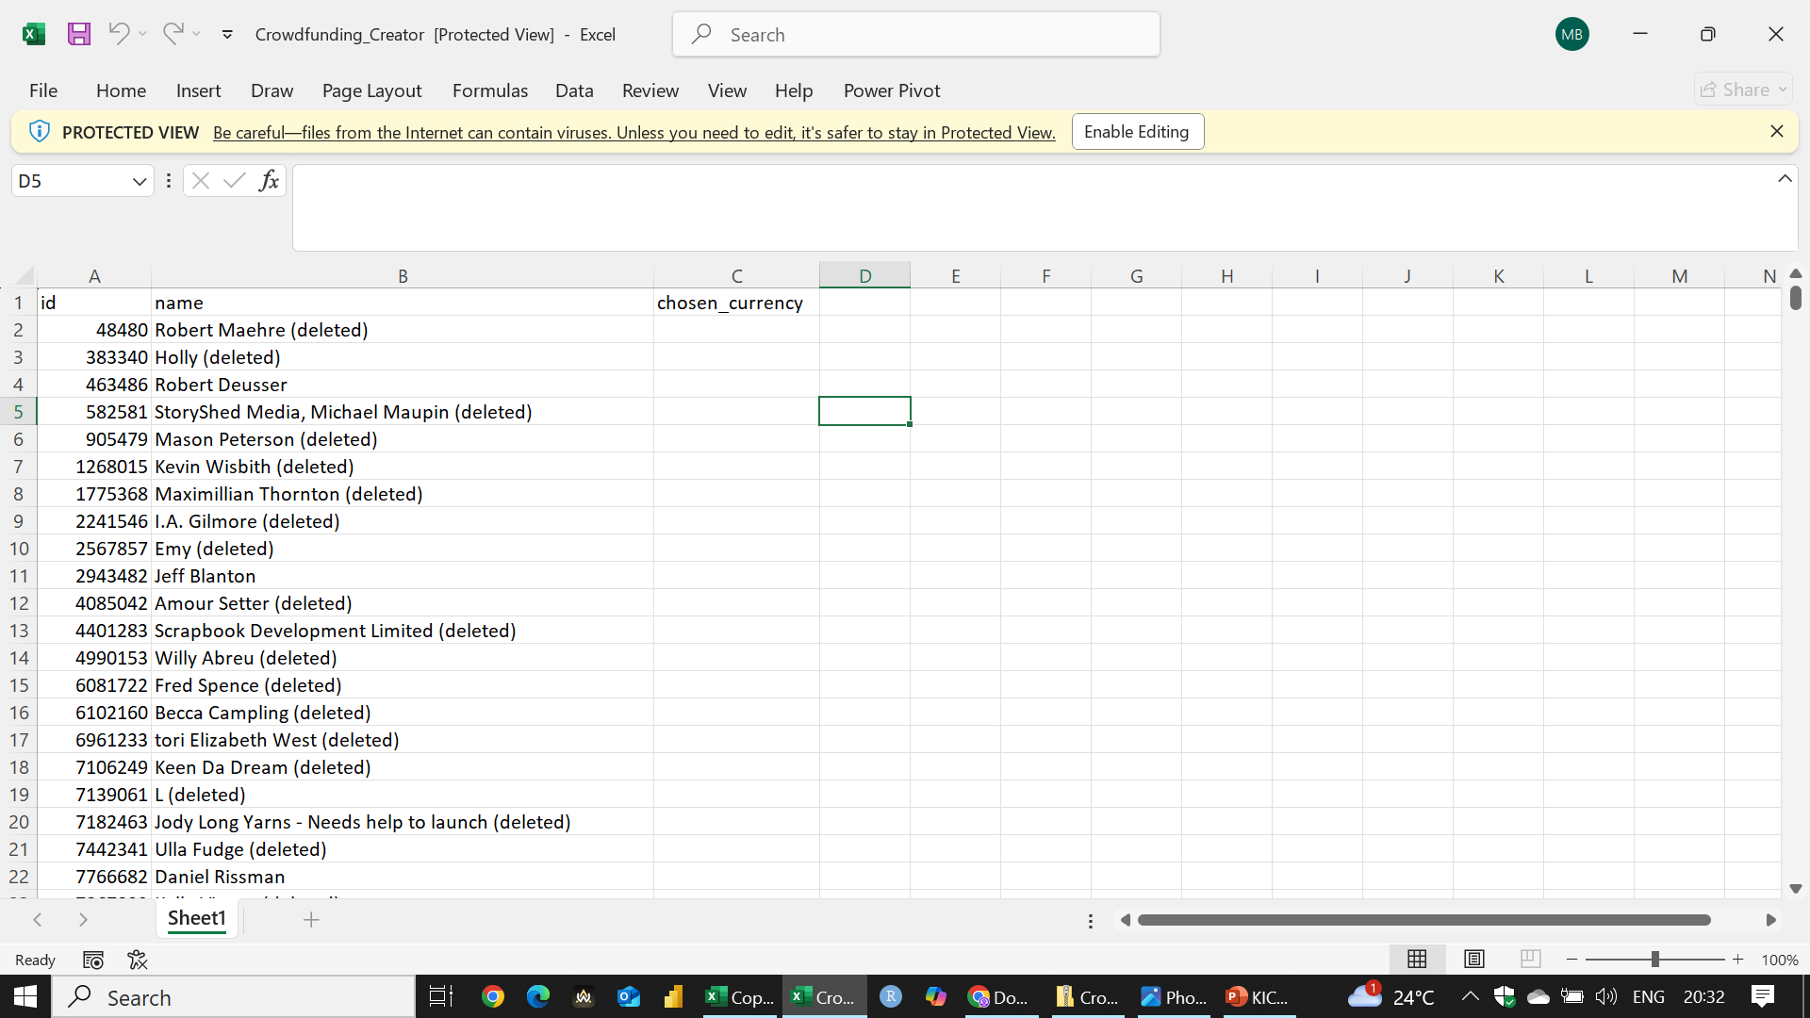
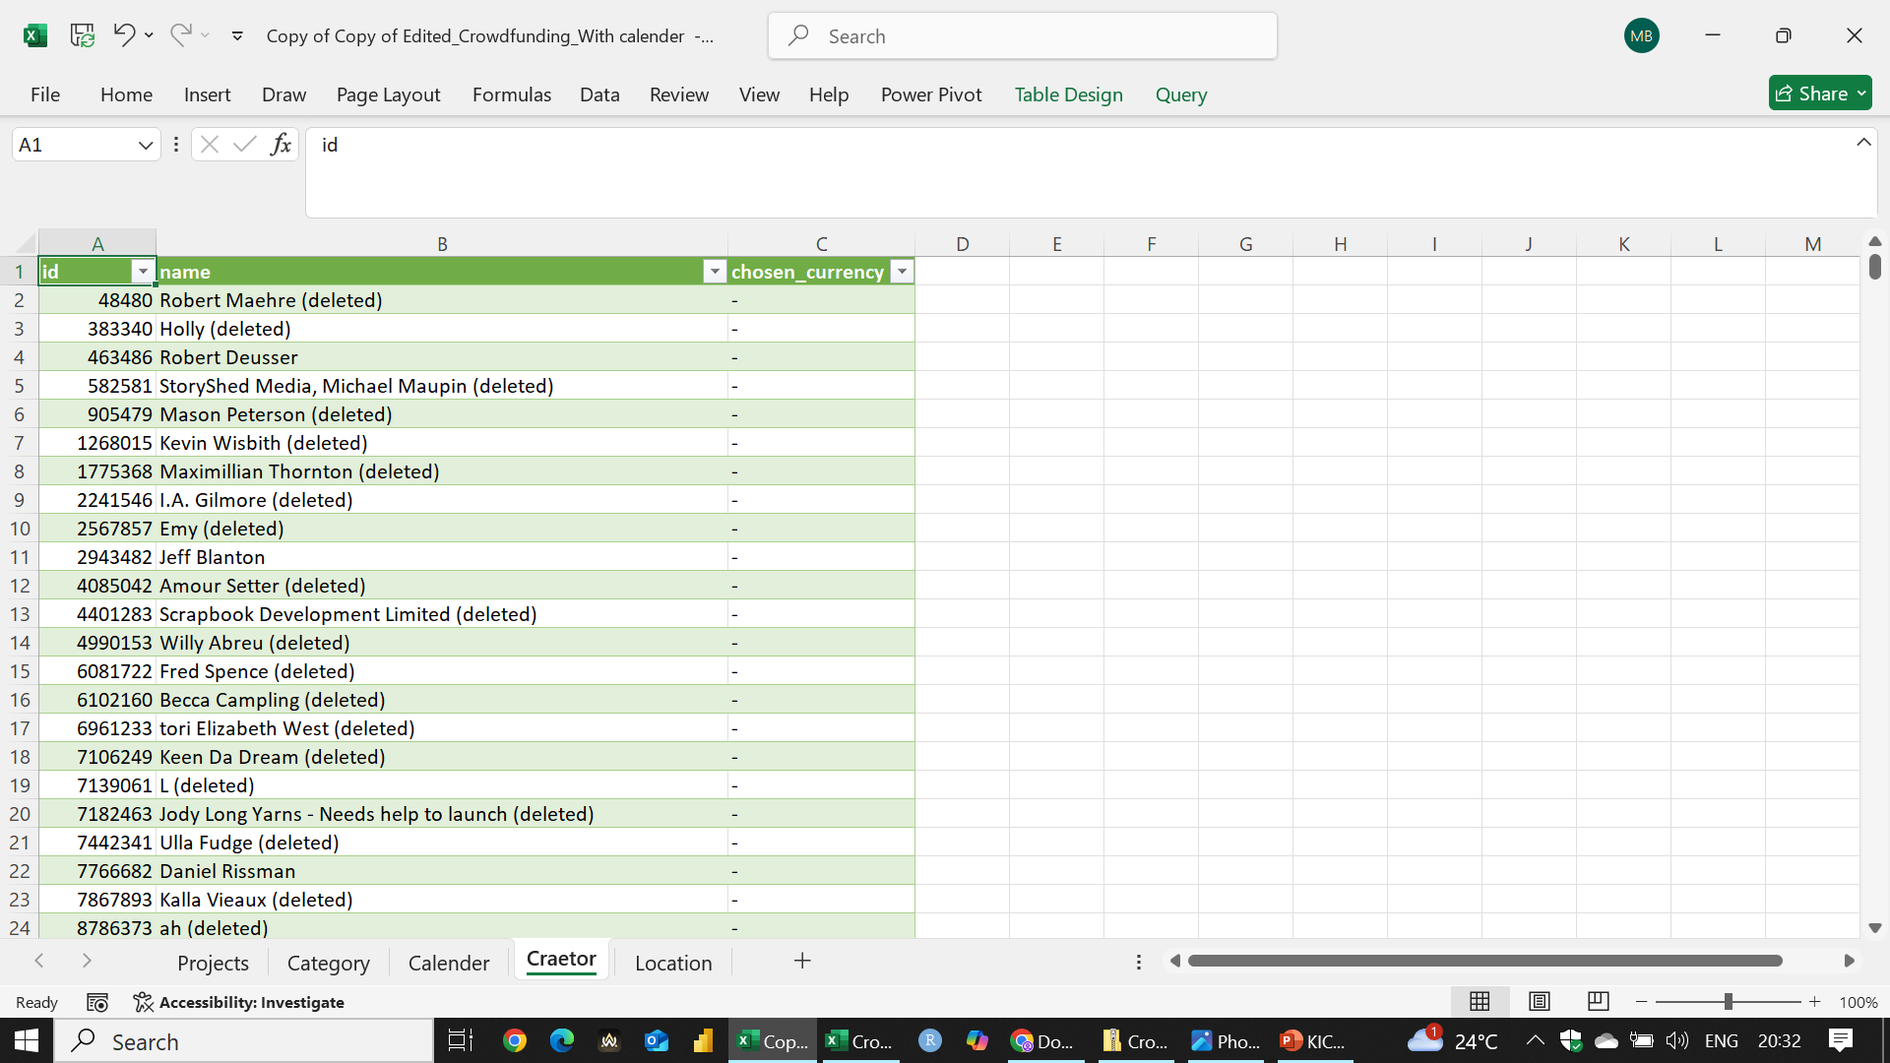

Slide 12
2. Visualization Using EXCEL

Slide 13
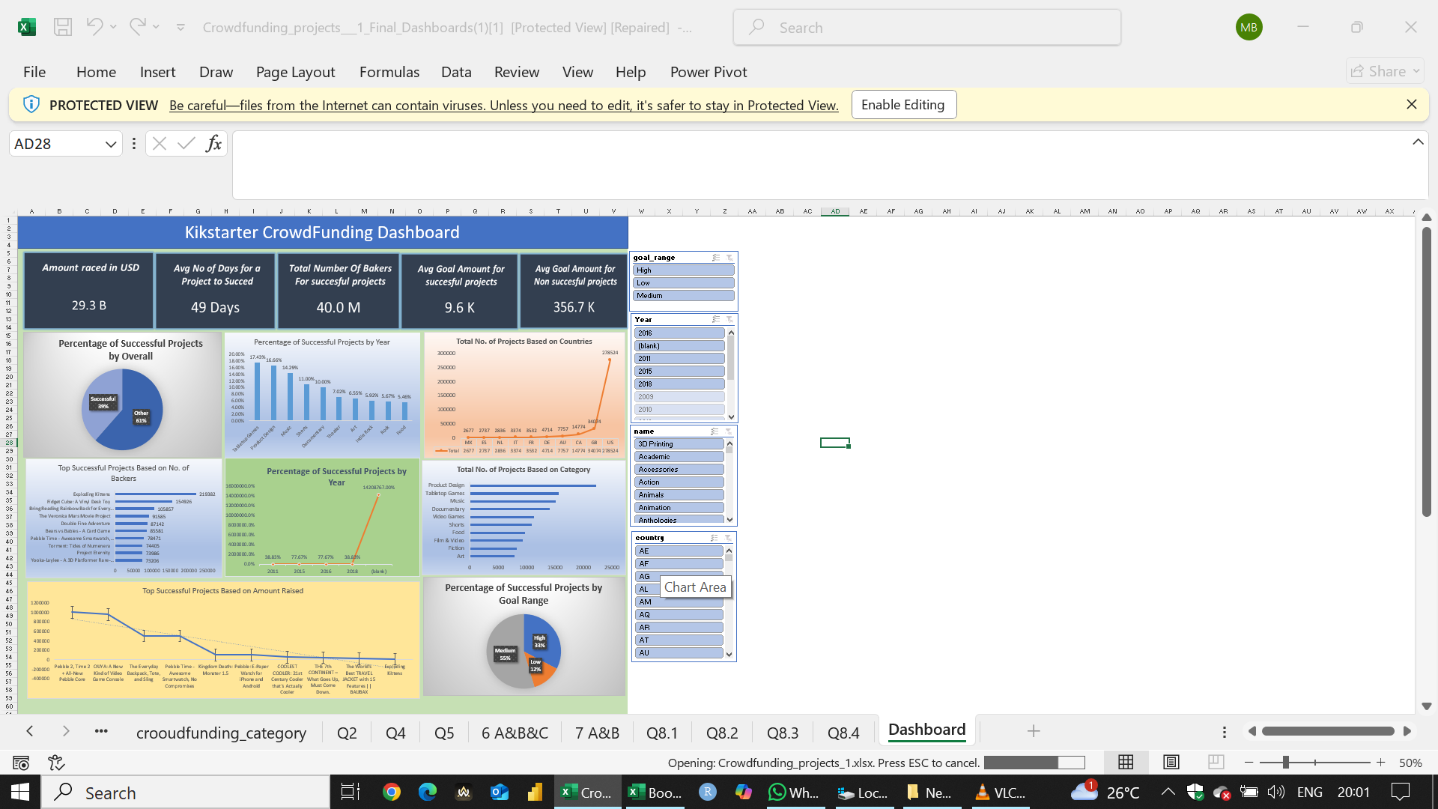

Slide 14
2. Visualization Using Power bi

Slide 15
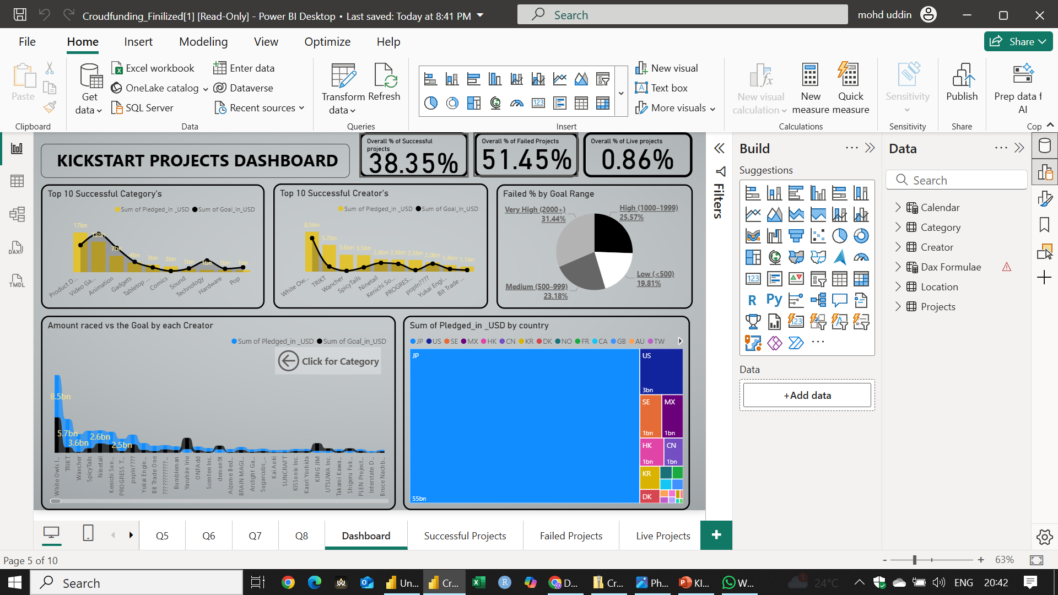

Slide 16
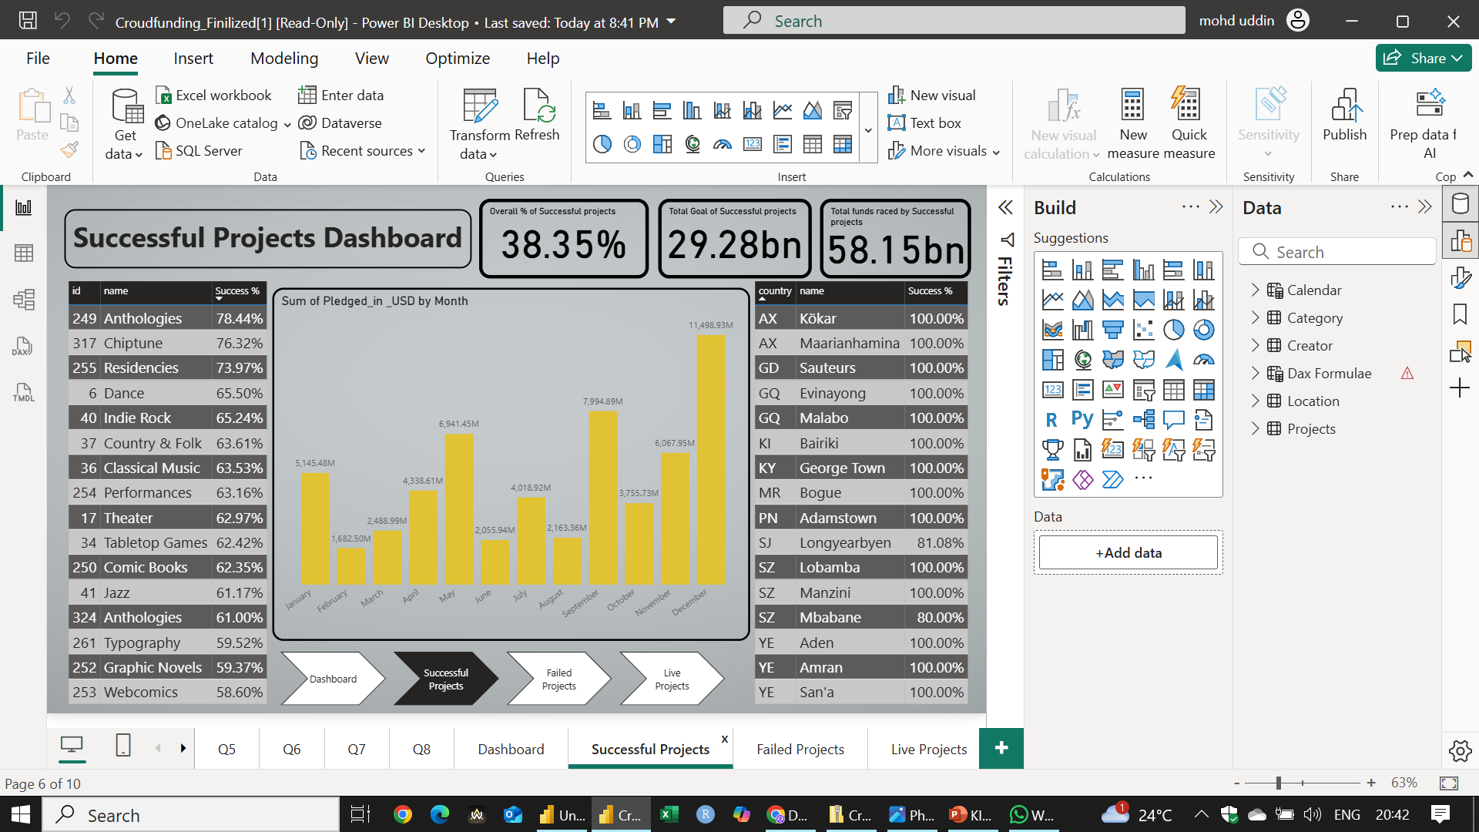

Slide 17
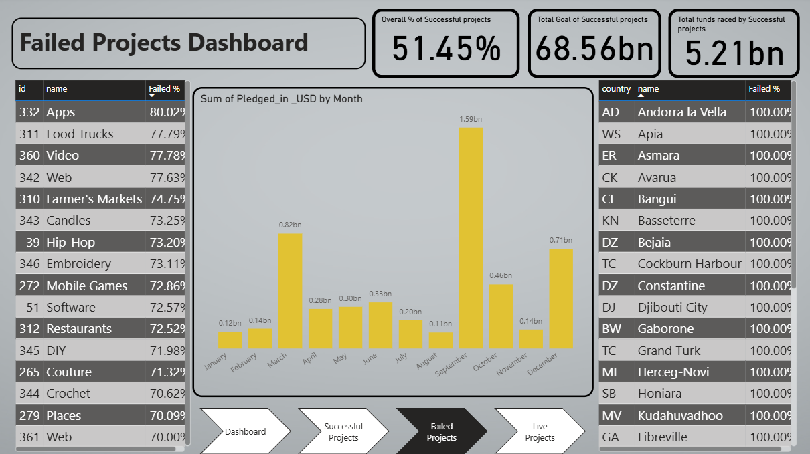

Slide 18
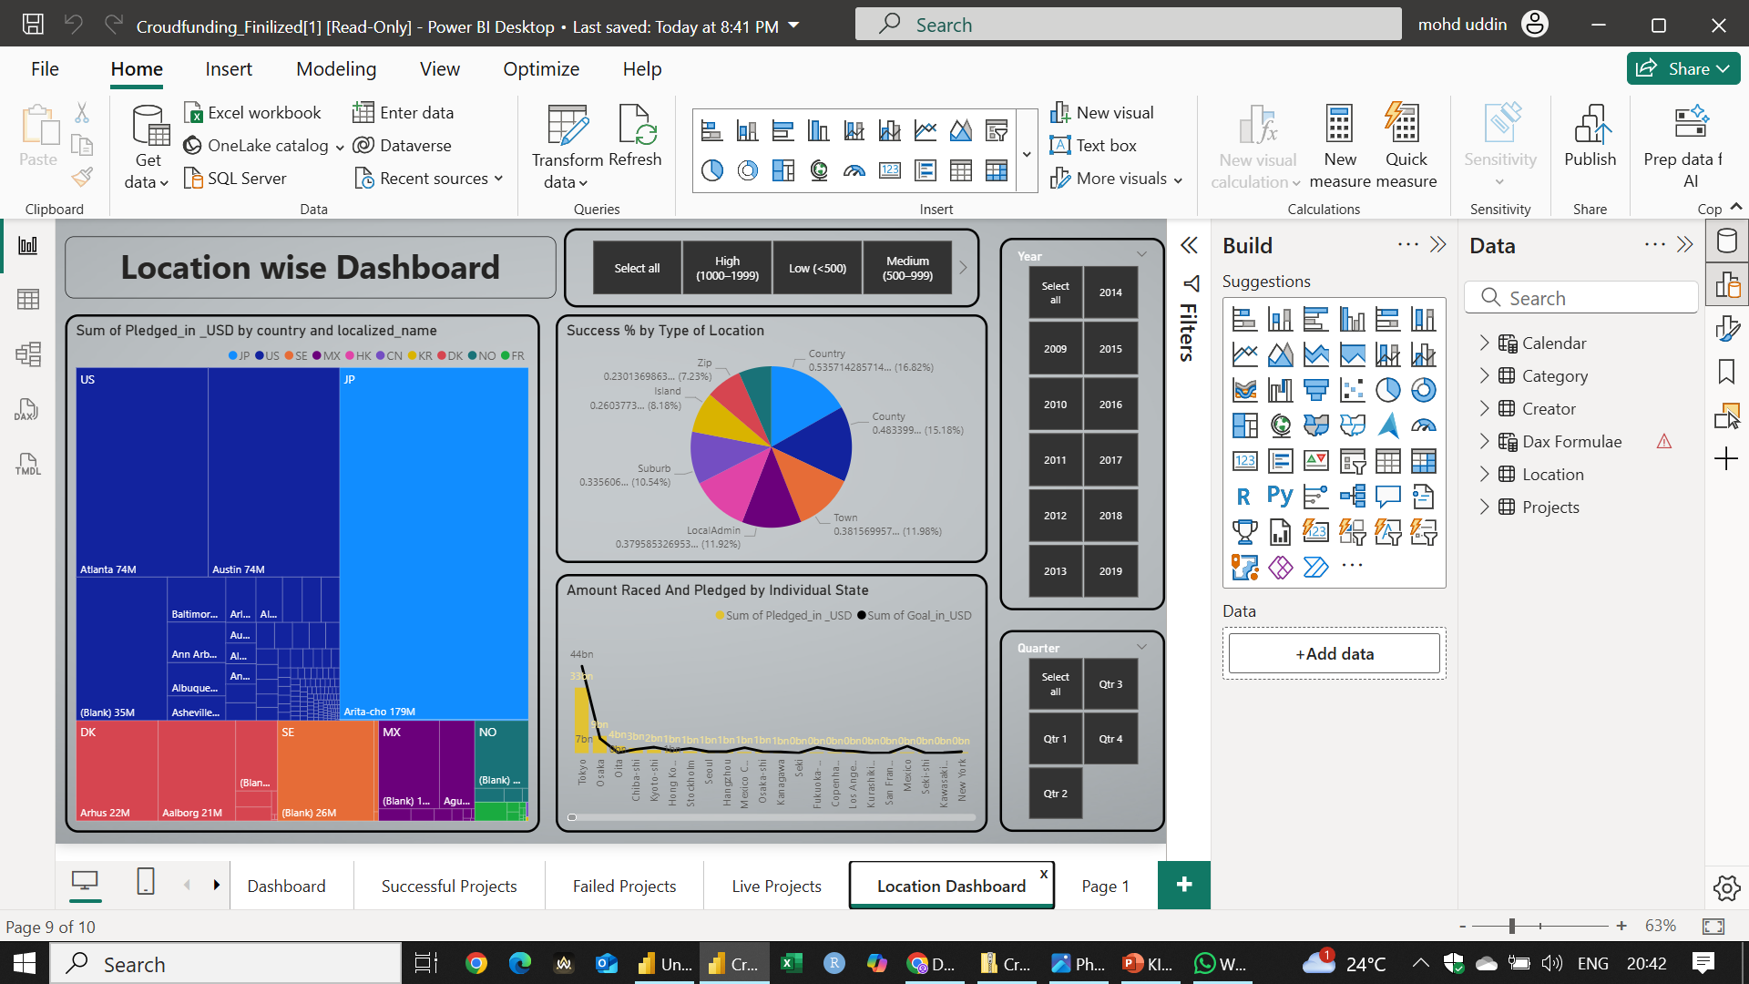

Slide 19
2. Visualization Using Tableau

Slide 20
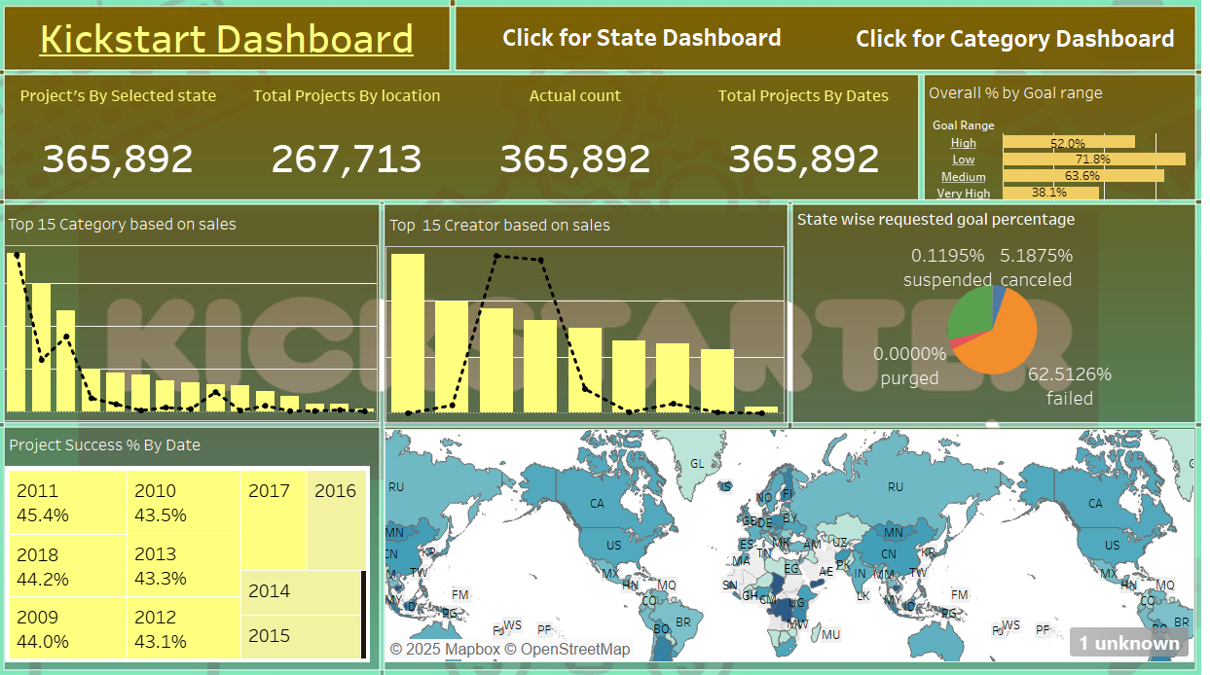

Slide 21
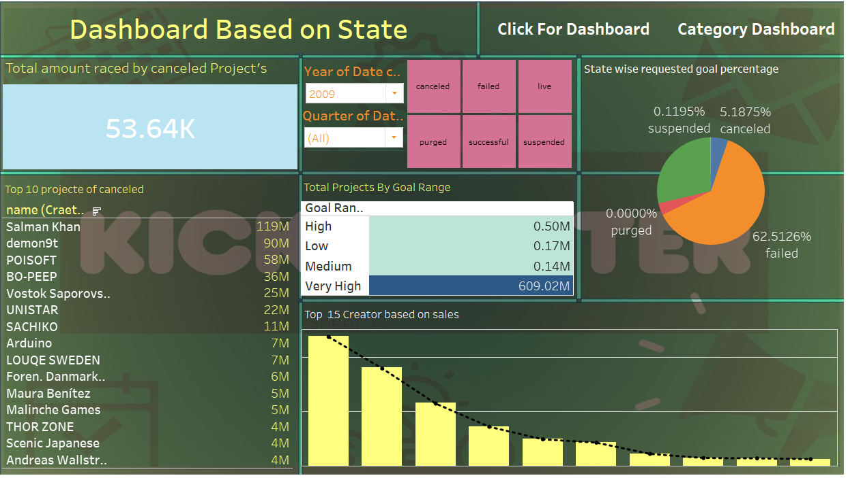

Slide 22
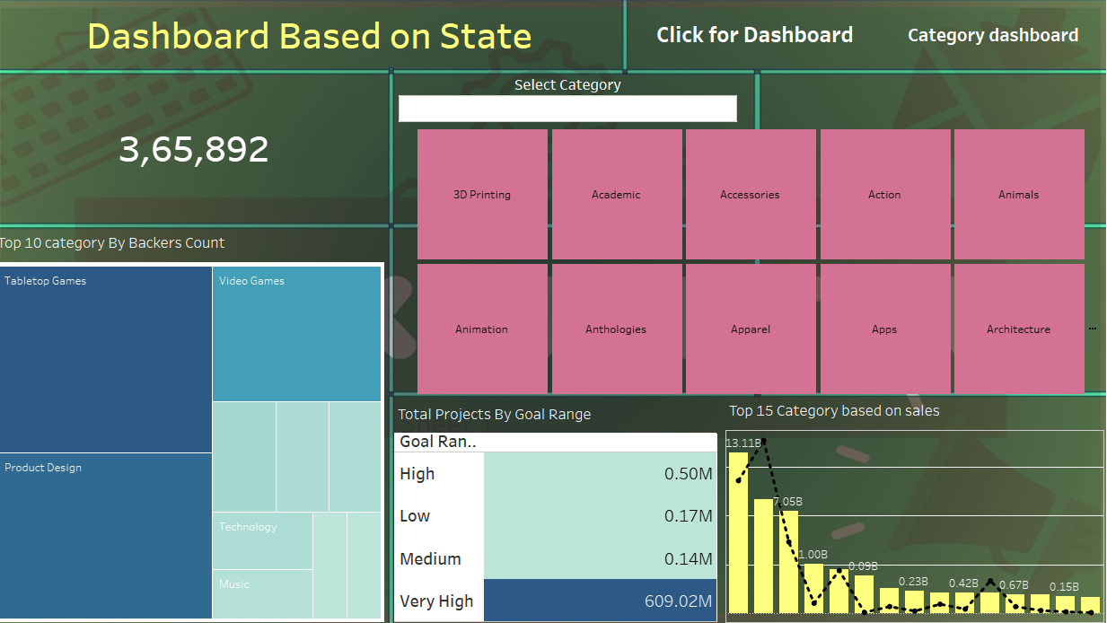

Slide 23
3.MODELING USING EXCEL

Slide 24
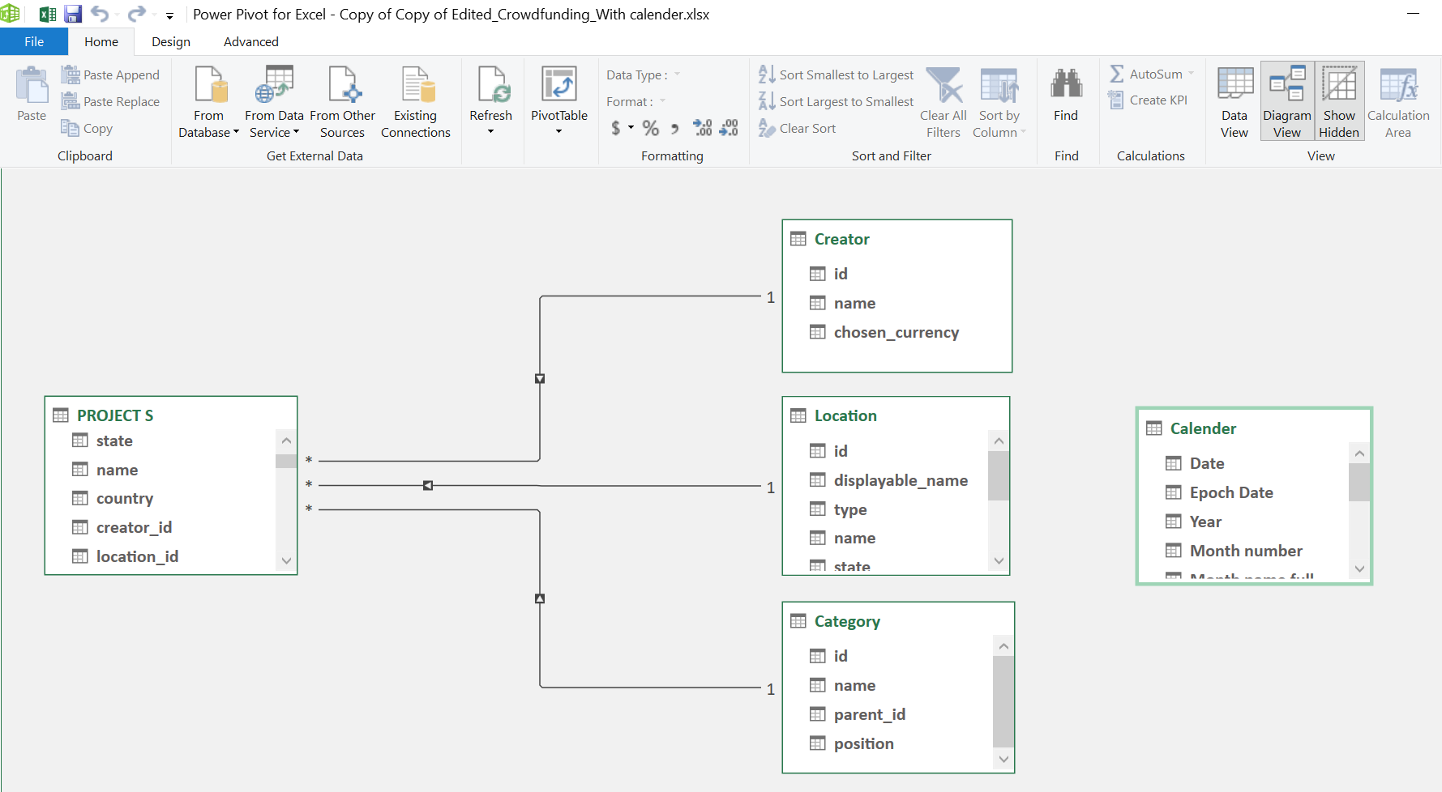

Slide 25
3.MODELING USING Power bi

Slide 26
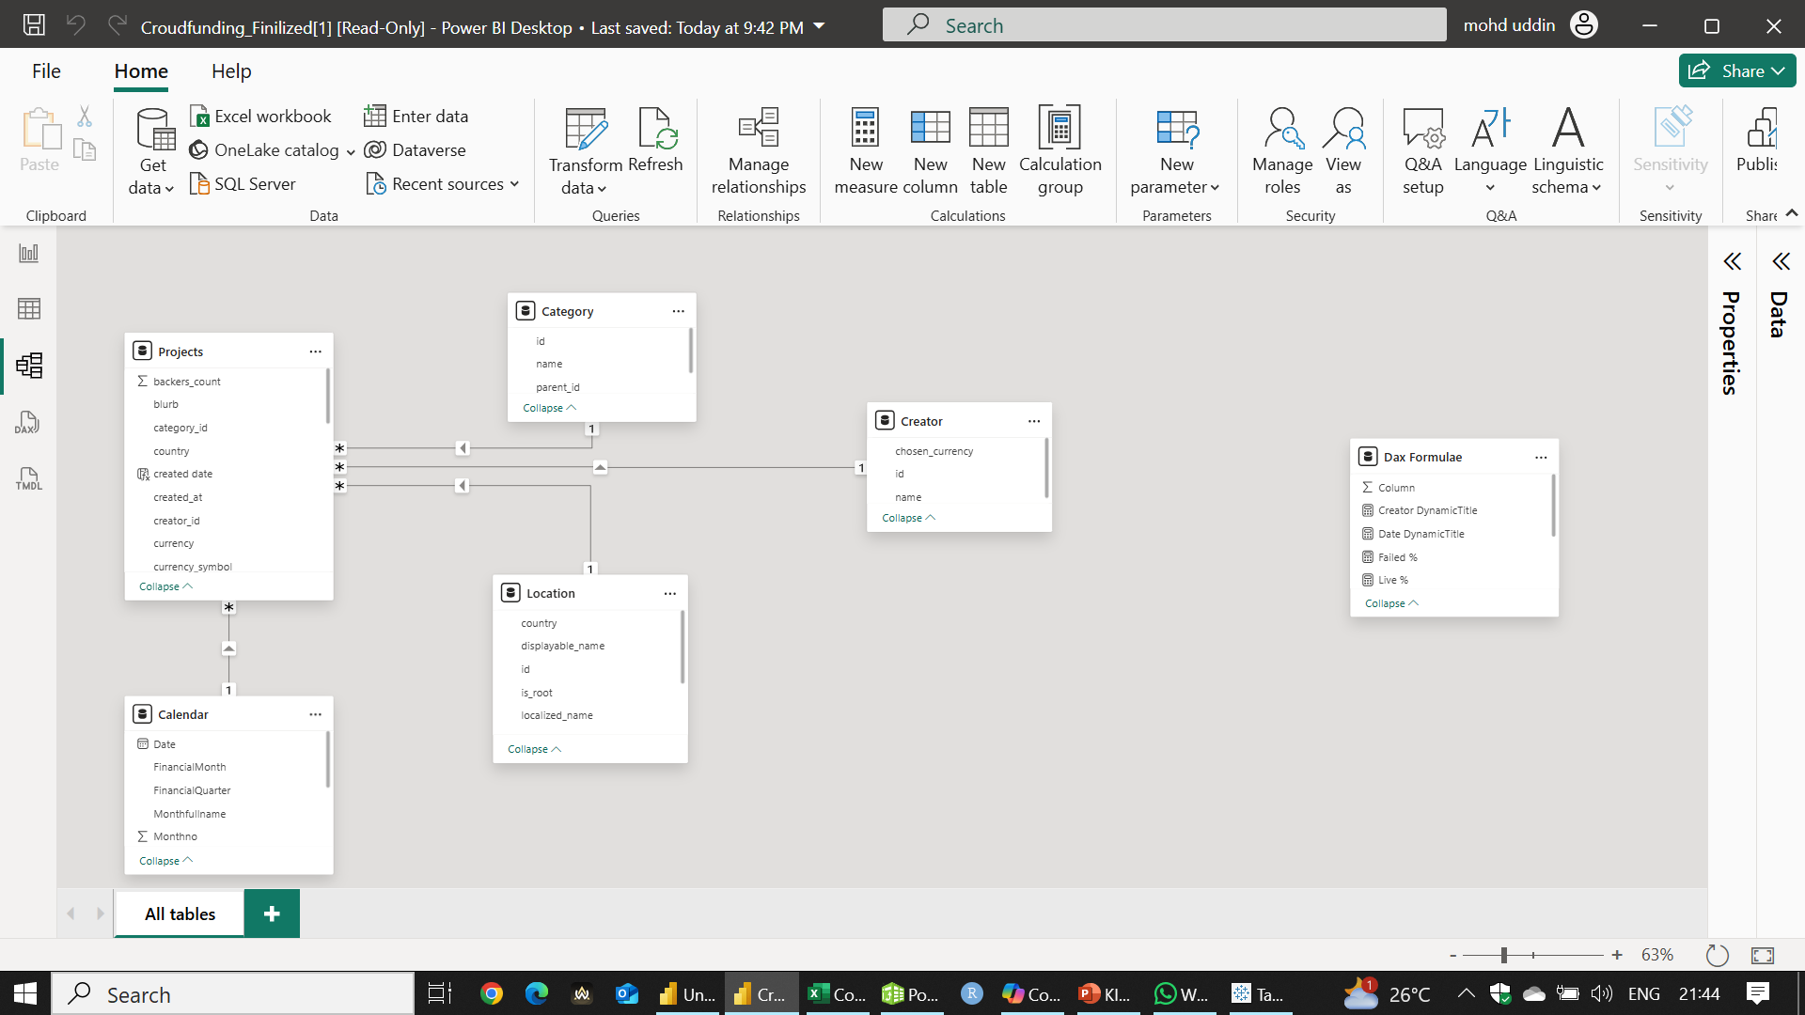

Slide 27
3.MODELING USING Tableau

Slide 28
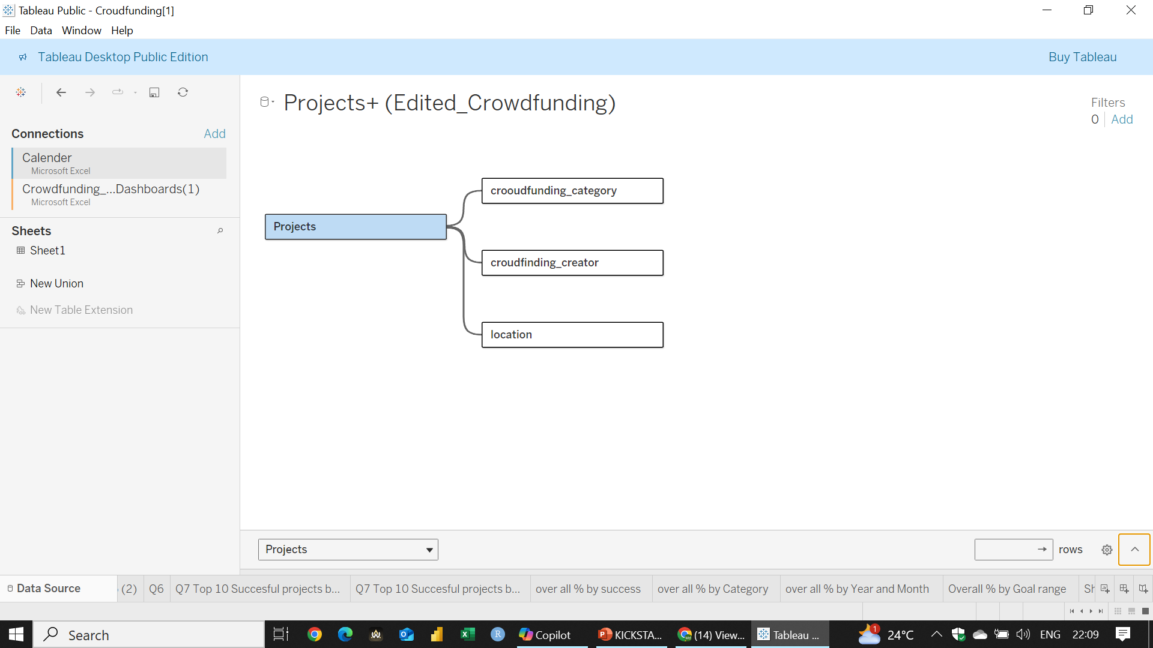

Slide 29
4. Text Analysis Using SQL

Slide 30
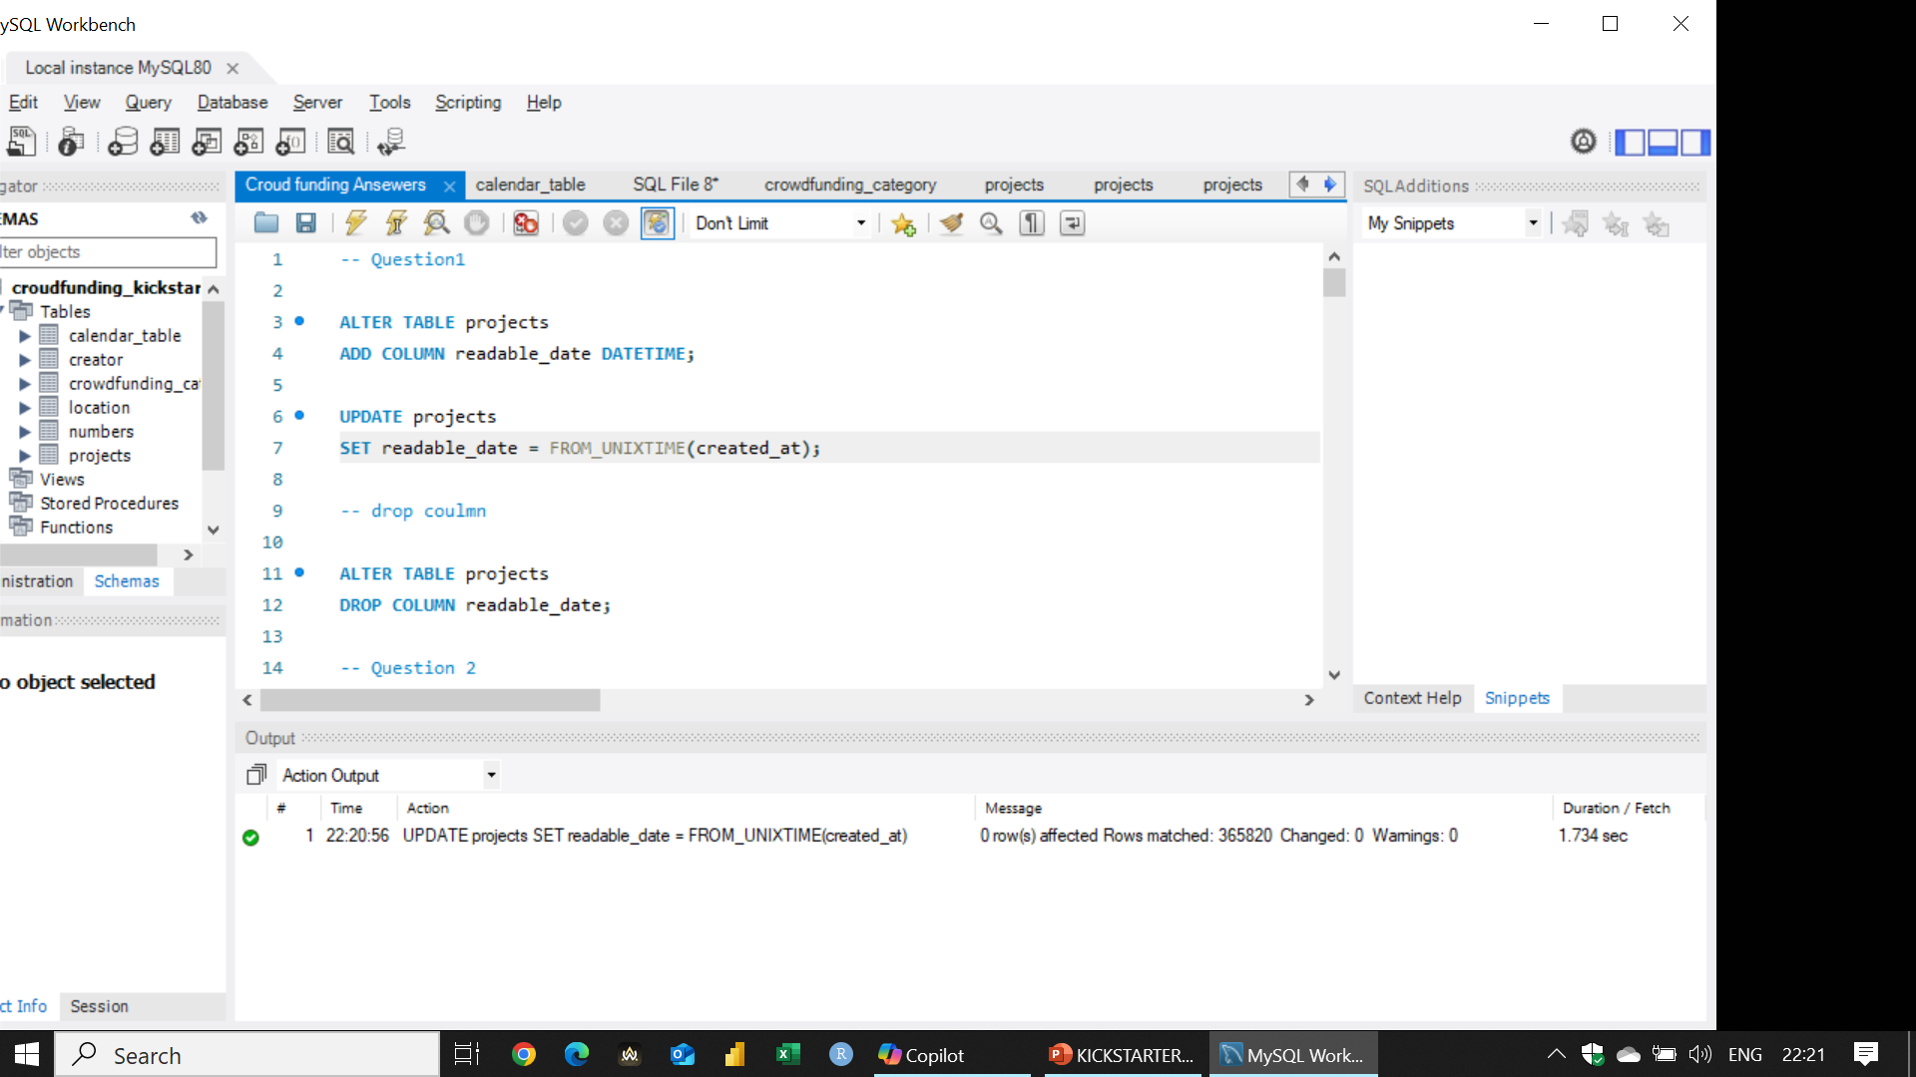
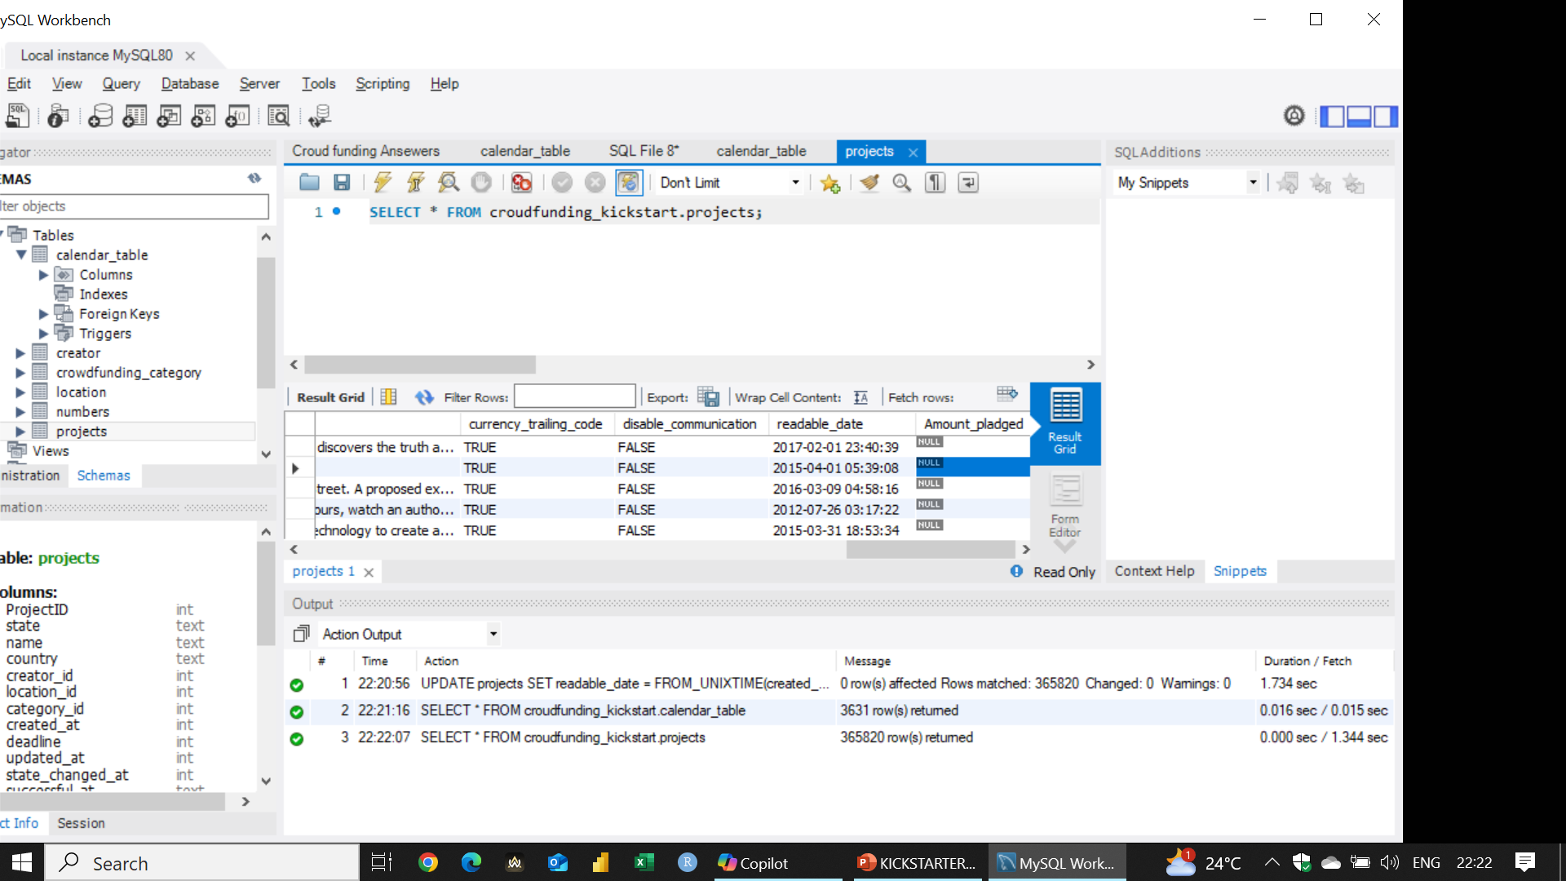
1st Question

Slide 31
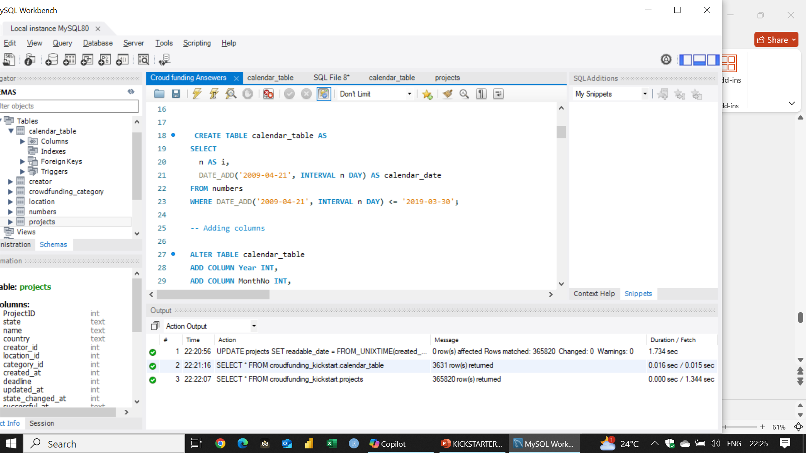
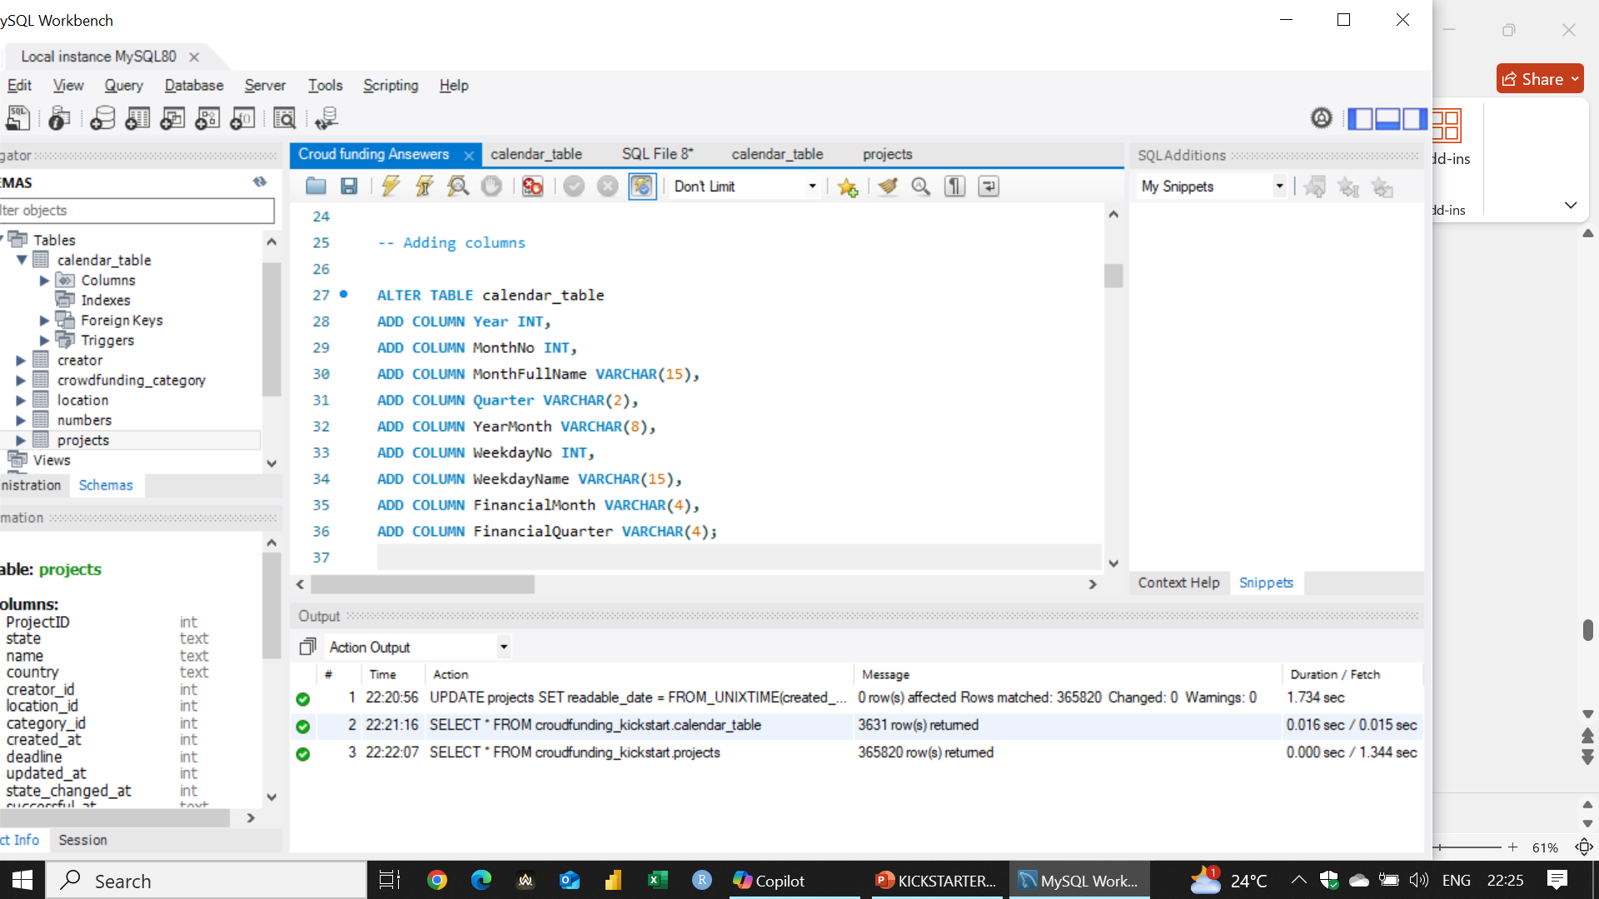
2nd Question

Slide 32
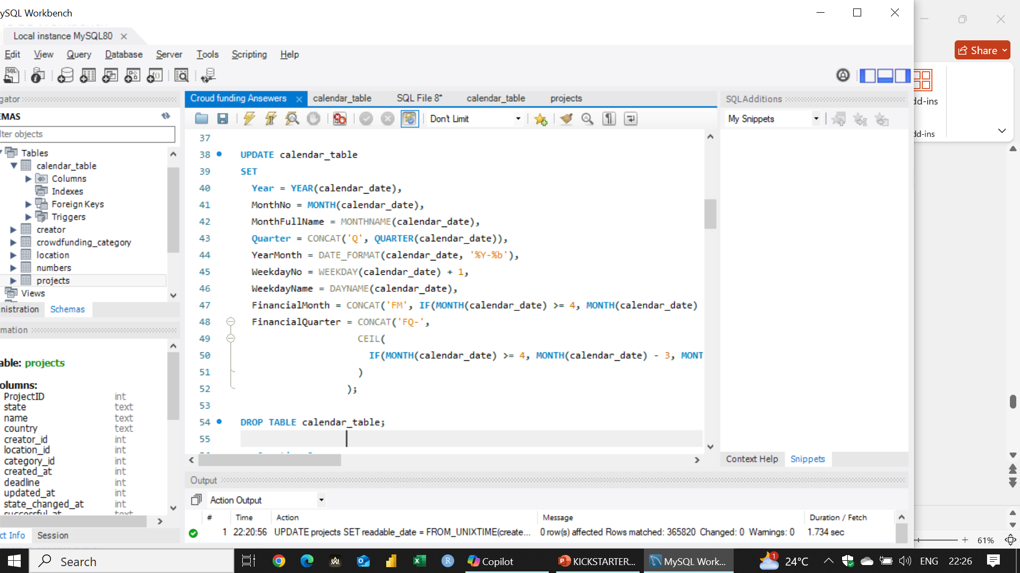
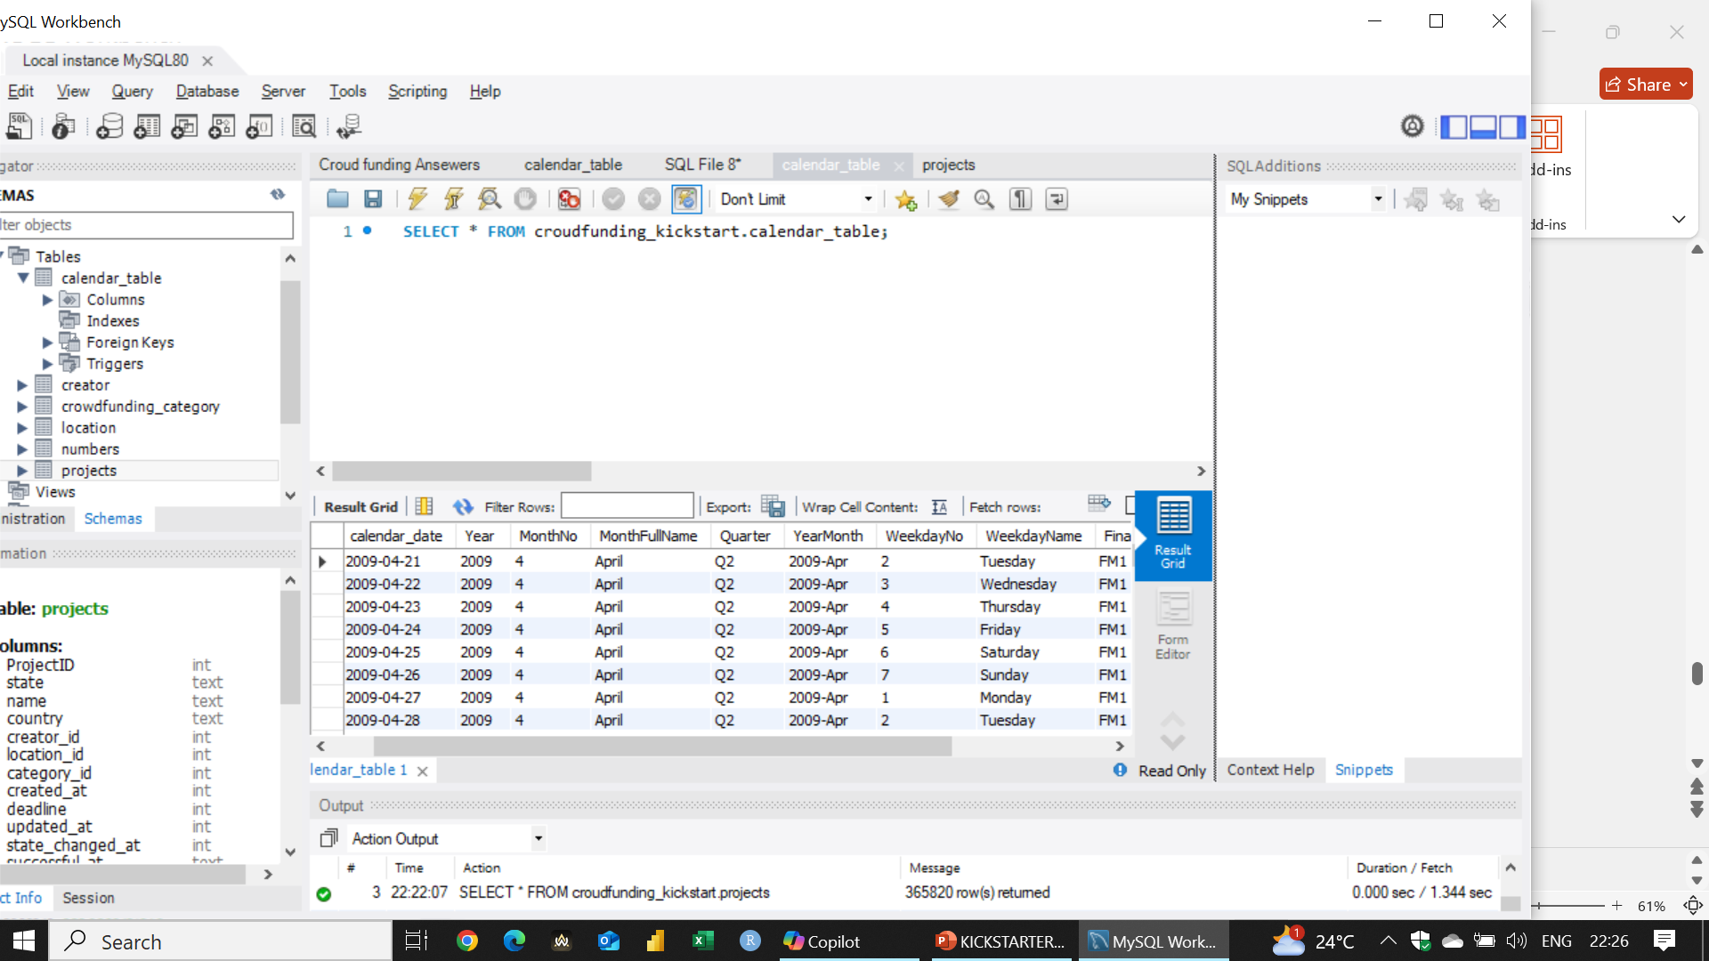

Slide 33
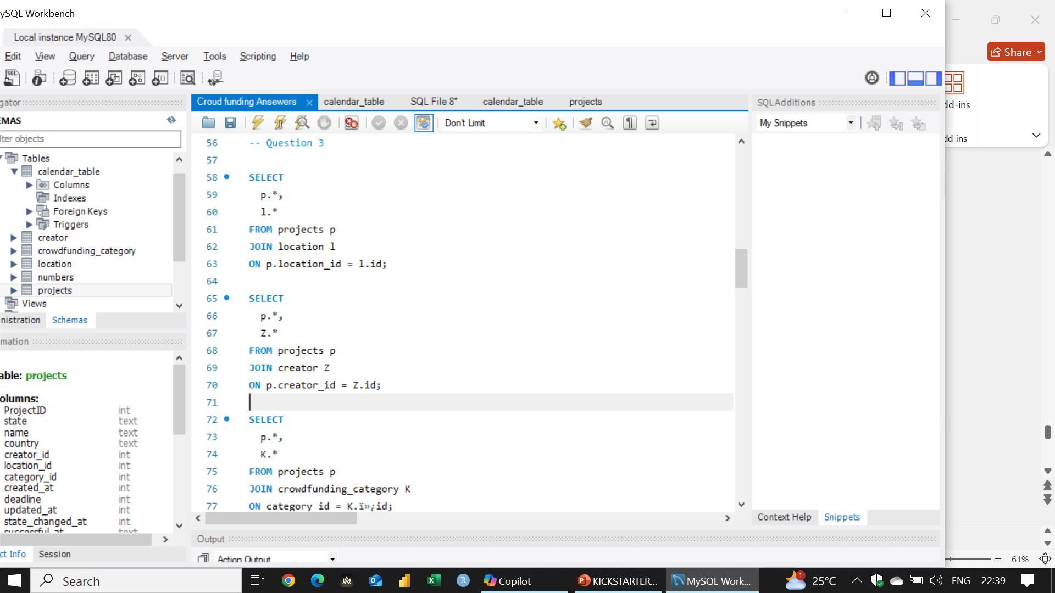
3rd Question

Slide 34
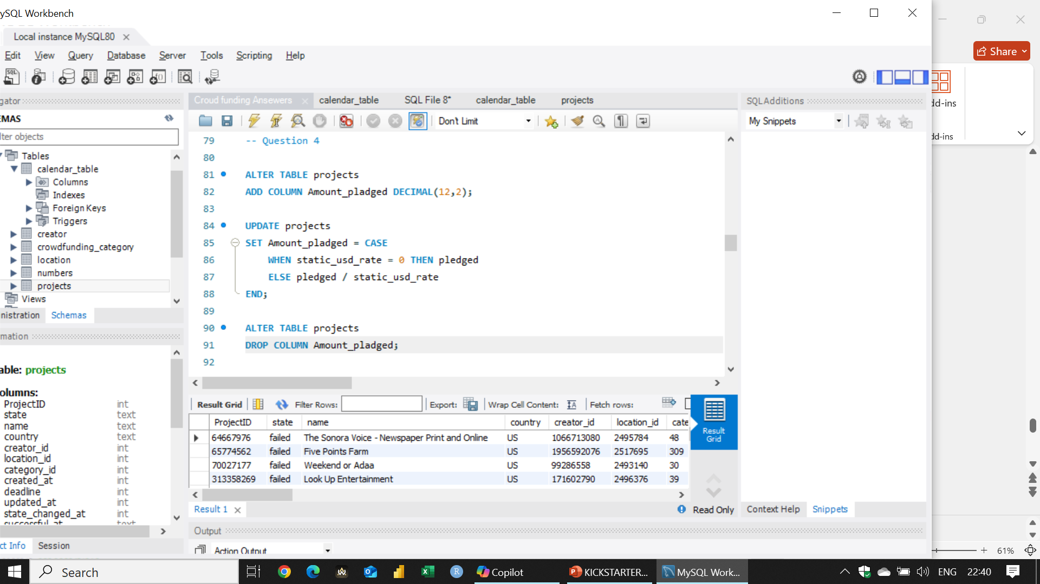
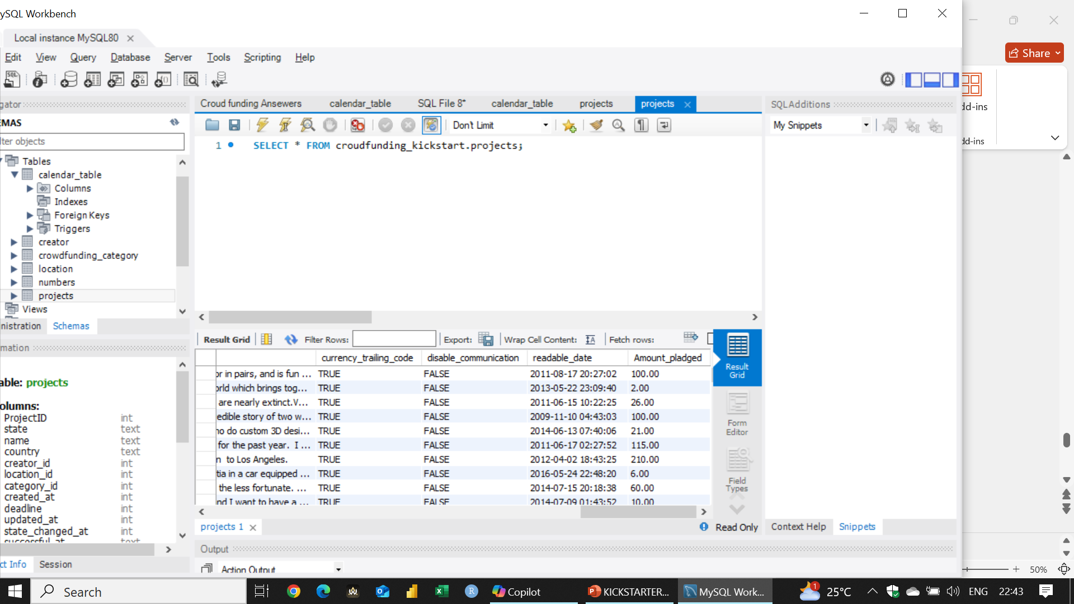
4th Question

Slide 35
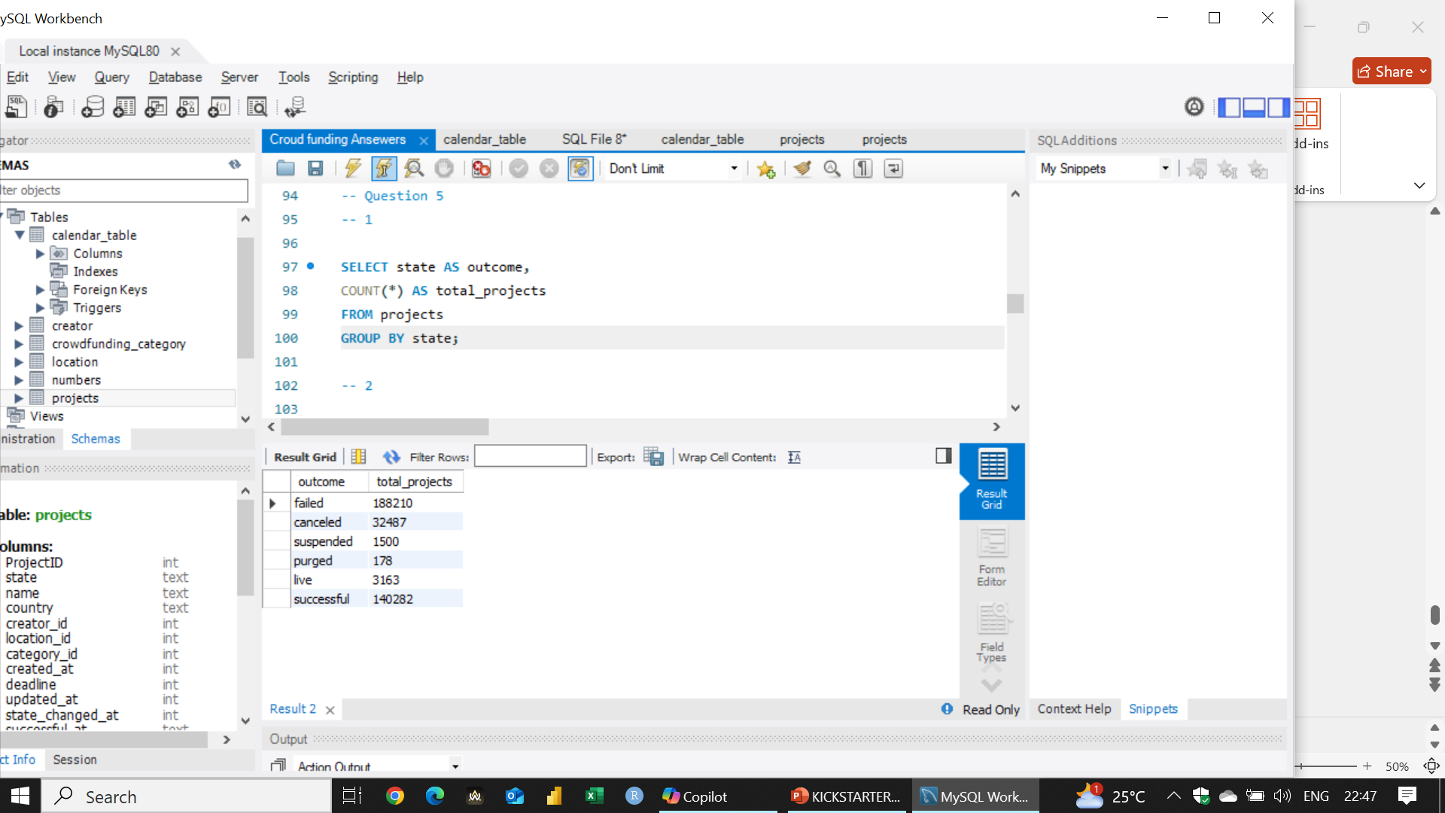
5.1th Question

Slide 36
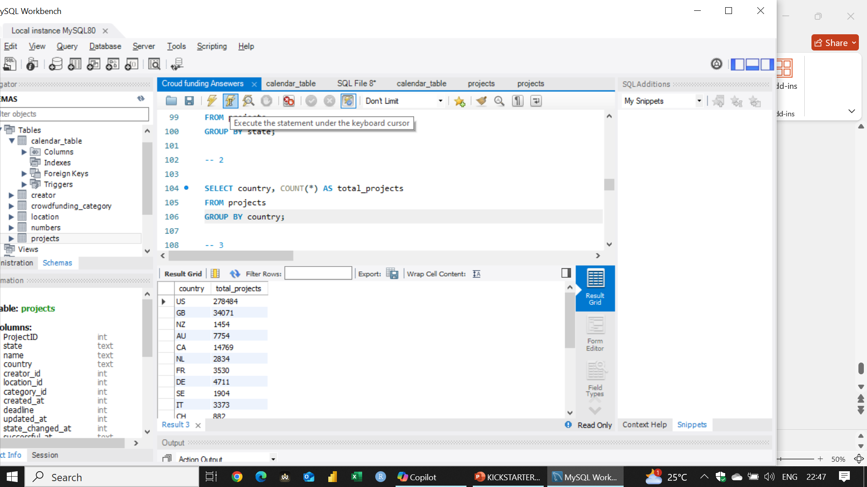
5.2th Question

Slide 37

5.3th Question

Slide 38
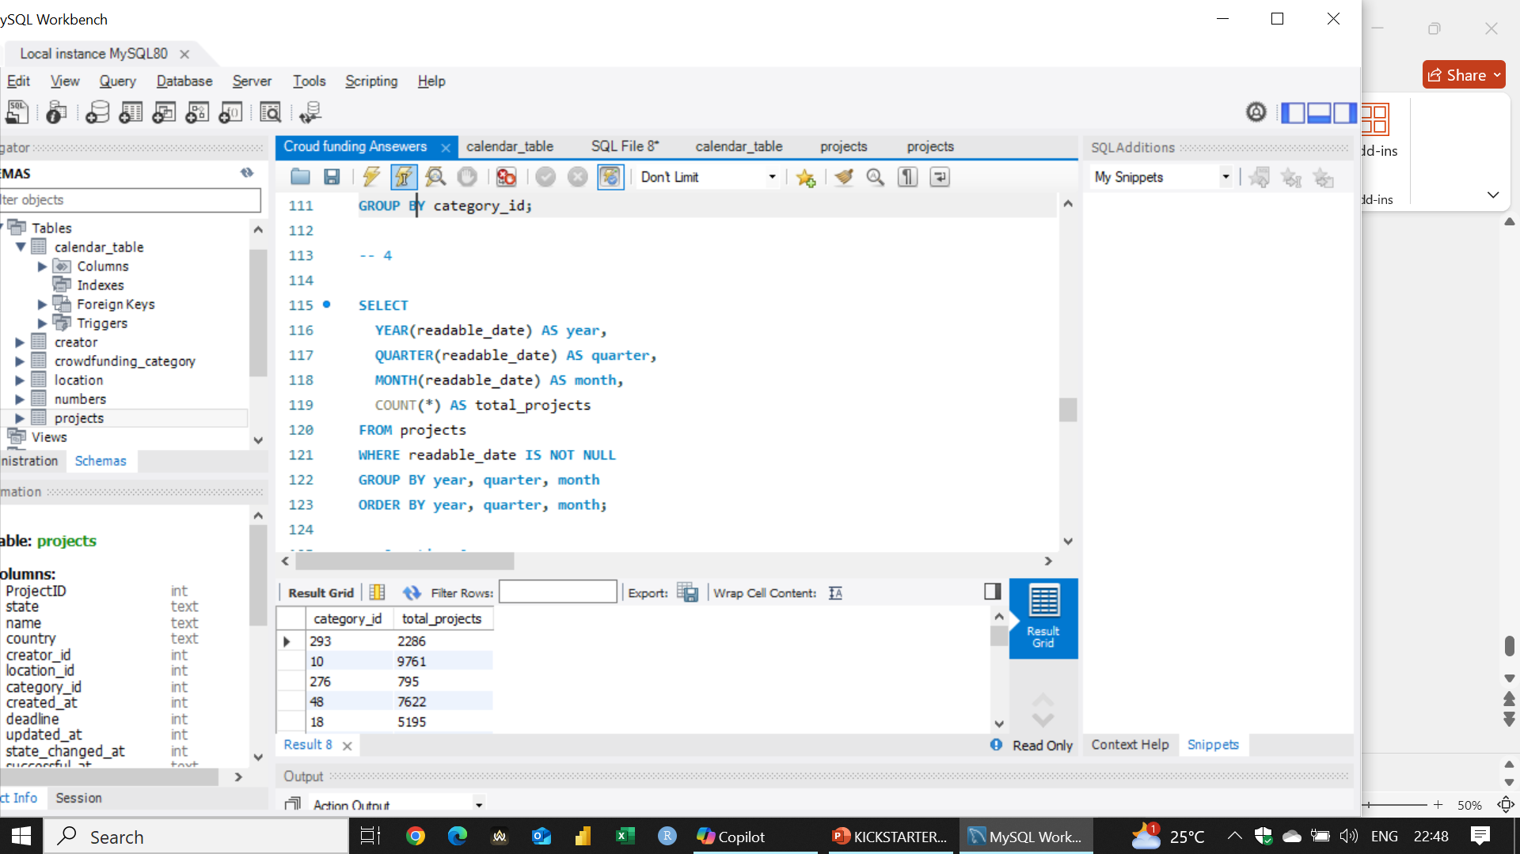
5.4th Question

Slide 39
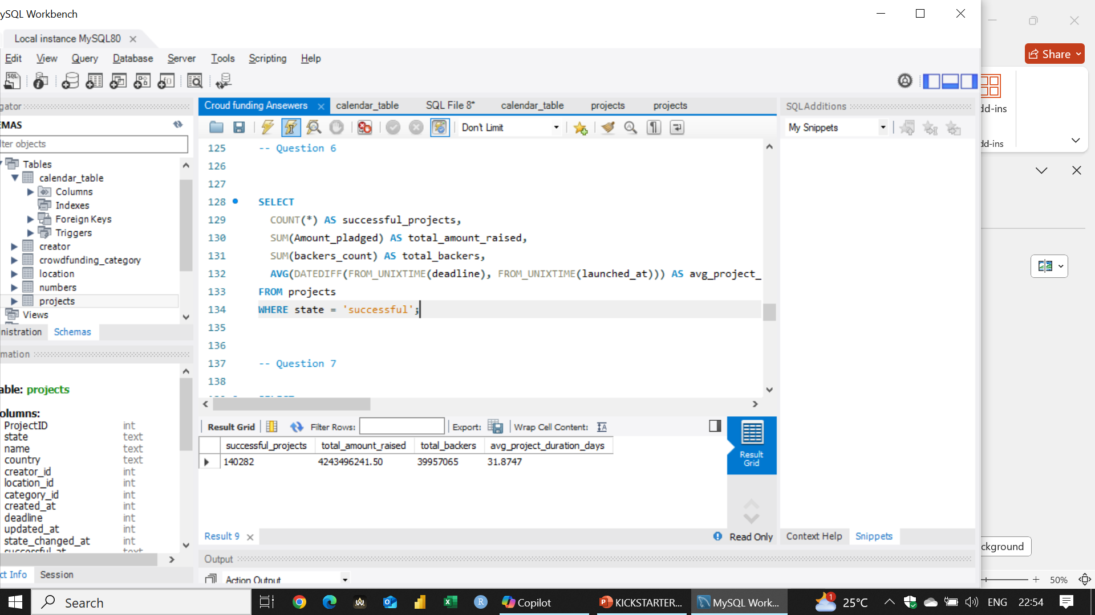
6th Question

Slide 40
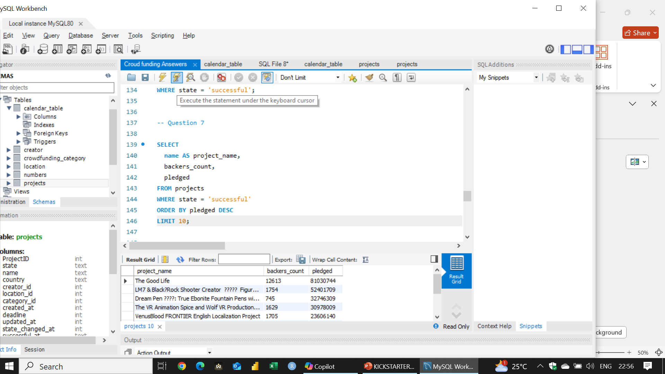
7th Question

Slide 41
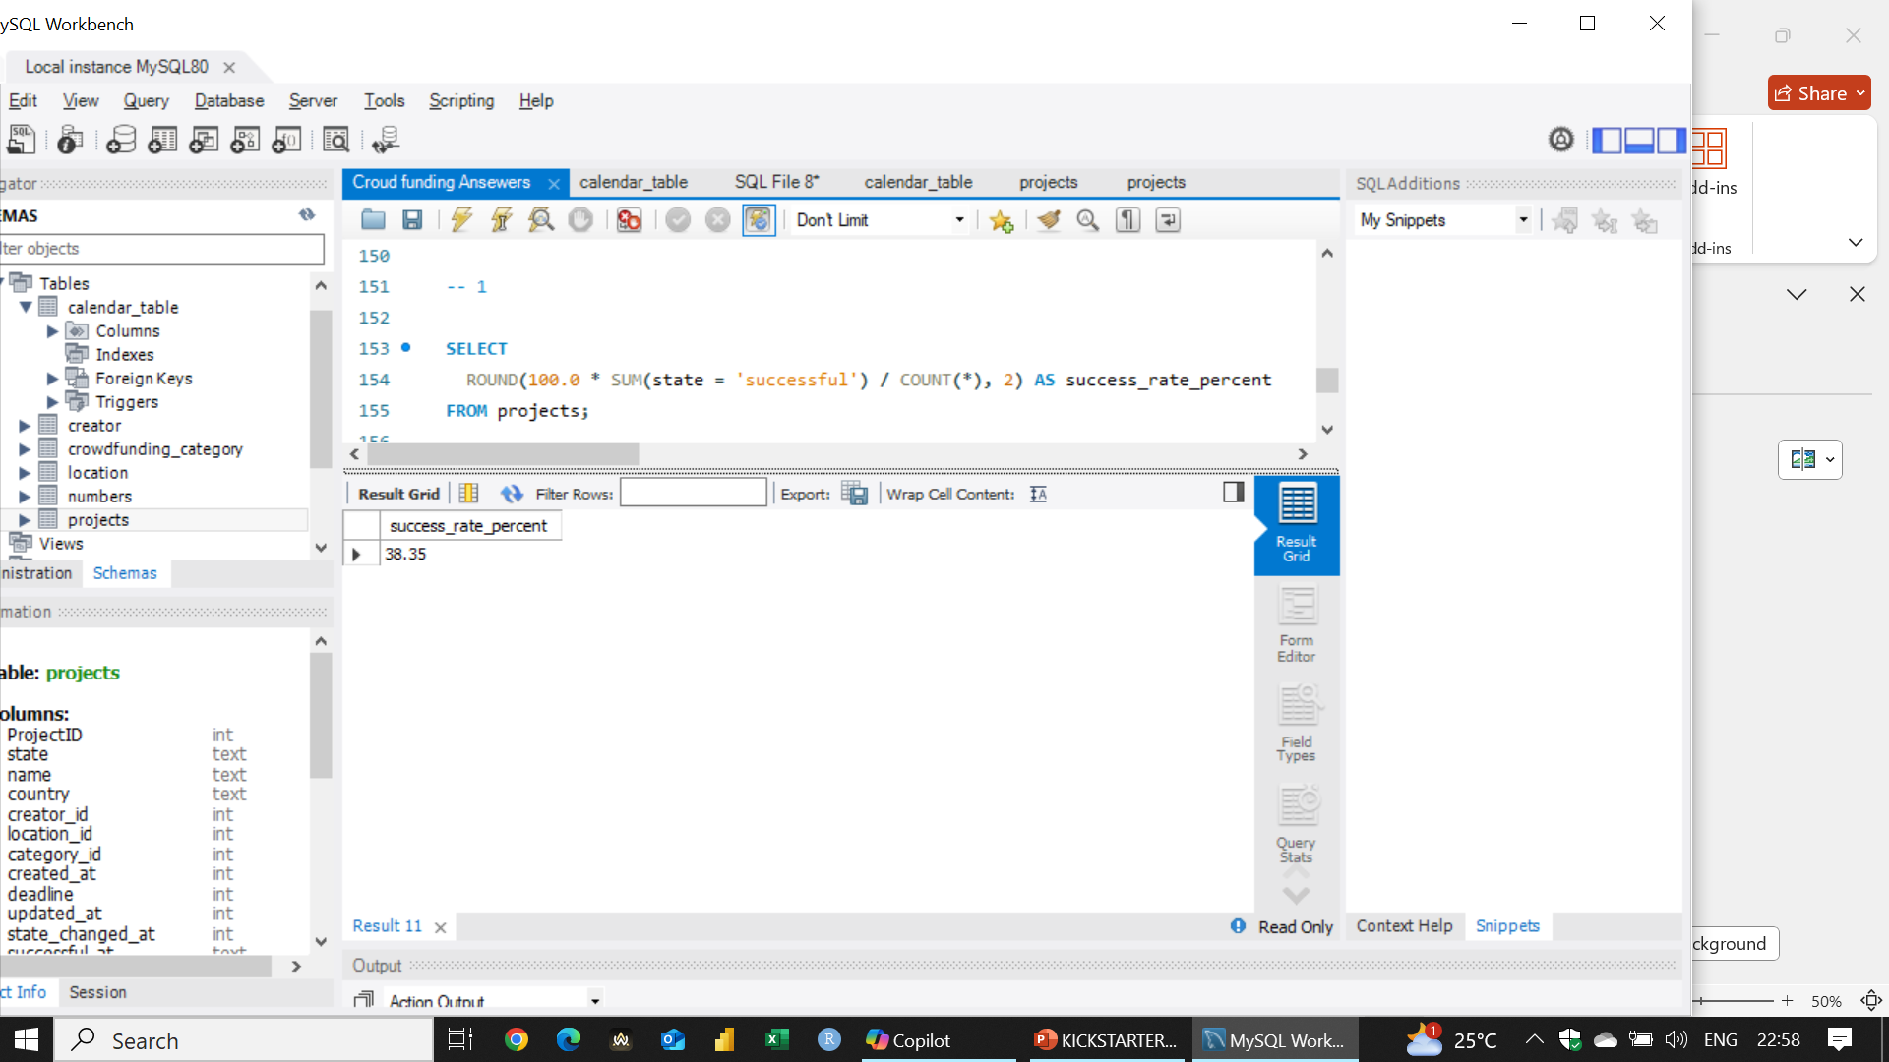
8.1th Question

Slide 42
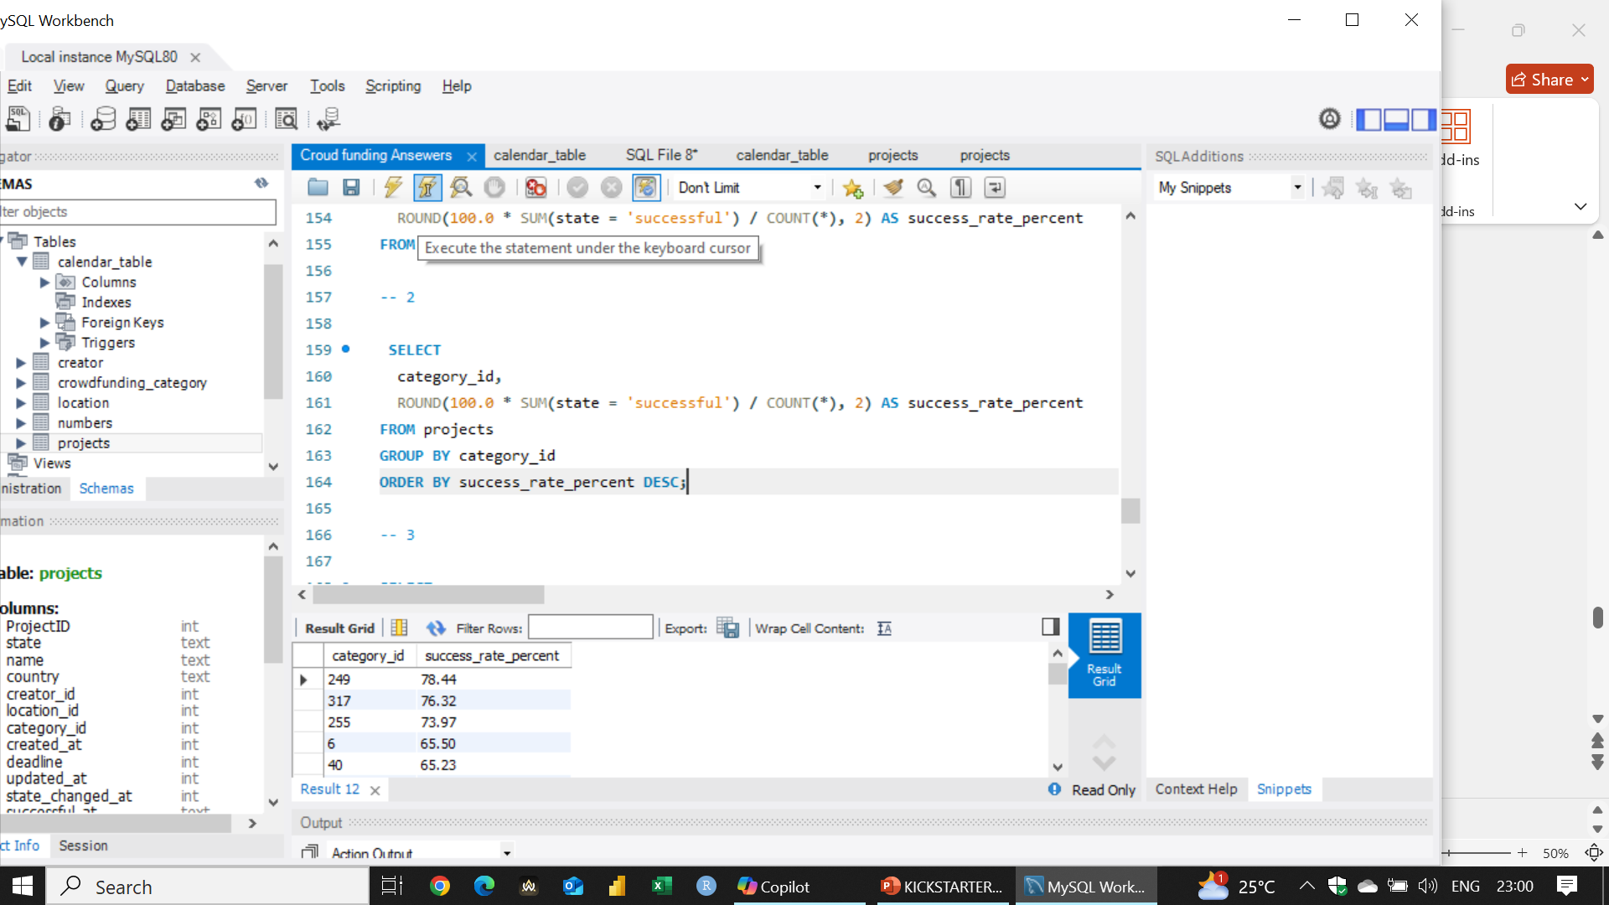
8.2th Question

Slide 43

8.3th Question

Slide 44
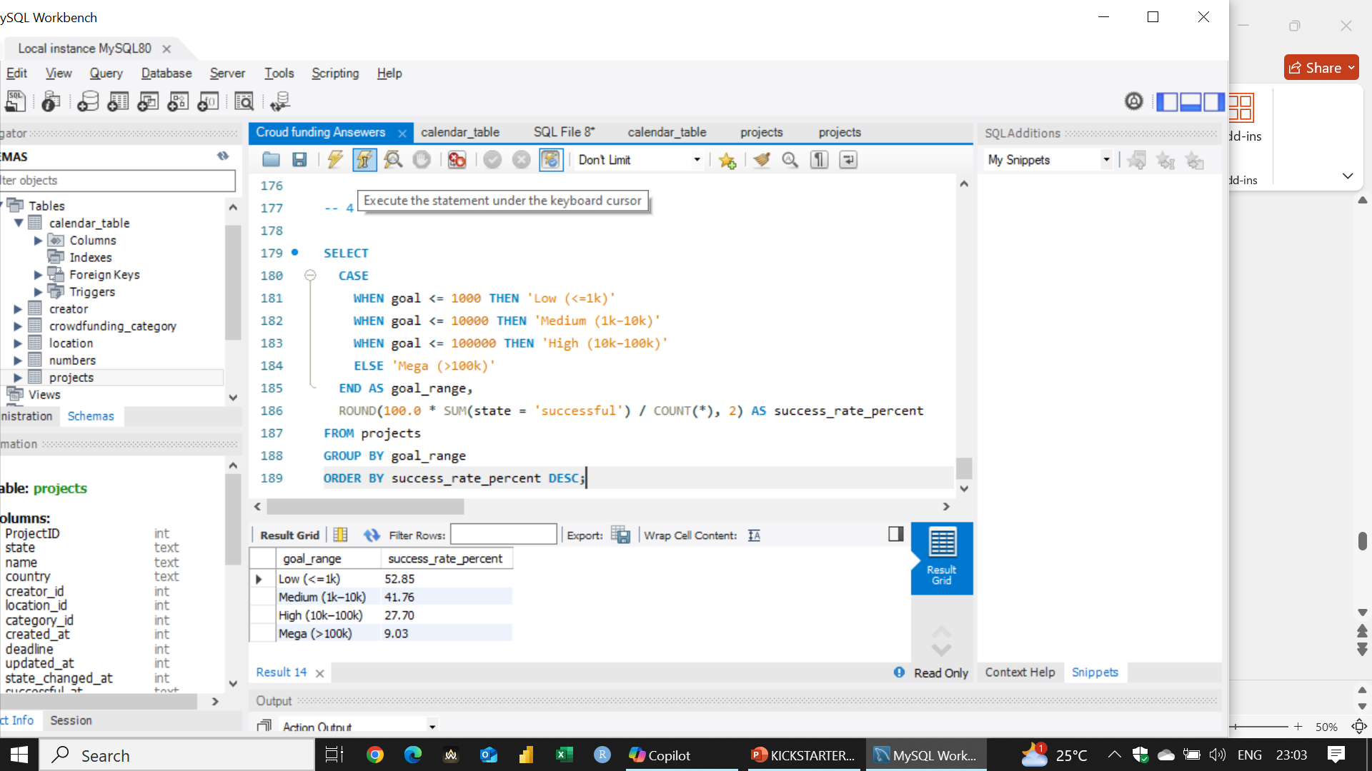
8.4th Question

Slide 45
PROBLEMS.
Declining Year-on-Year Sales / Pledges
Low Project Success RateModeling
Declining Backer Engagement
Regional Growth Stagnation
High Rate of Project Abandonment or Fraud

Slide 46
SOLUTION TO PROBLEM 1.
Identify high-value backers (via RFM analysis) and retarget them with curated project recommendations
Use historical pledge data to find high-performing months and promote campaigns more heavily during those times.
Forecast pledge drop ahead of time and launch early interventions (email marketing, creator boosts).
Work on marketing in the Countries with low performance
Creating a united Payment method To engage Foren investors

Slide 47
SOLUTION TO PROBLEM 2.
Use insights from successful campaigns to create an onboarding guide, best practices, or AI-based coach for new creators.
Introduce a goal recommendation tool based on category and region using historical data.
Show creators a “success probability” score during project creation to help improve before launch.

Slide 48
SOLUTION TO PROBLEM 3.
Introduce badges, ranks, or reward credits for frequent or high-value backers.
Use machine learning to send timely, personalized project recommendations based on backer interest
Require funded creators to send milestone updates this improves transparency and builds trust.
Encourage creators to offer creative/early access rewards based on analysis of past backer preferences.

Slide 49
SOLUTION TO PROBLEM 4.
Run region-specific workshops and feature local success stories.
Expand the platform’s support for local currencies and languages to make it accessible
Highlight culturally relevant project categories in each region using usage pattern clustering.
Run ads on region-specific social platforms using data-backed category focus.

Slide 50
SOLUTION TO PROBLEM 5.
Use machine learning to flag suspicious campaigns
Introduce a public trust score for creators based on past delivery, updates, and backer feedback.
Require ID/document verification and KYC checks before projects go live.
Release funds in stages based on milestone delivery (verified by backer feedback or uploads).

Slide 51
Conclusion.
Kickstarter is a rich platform for data-driven insights
Great use case for classification, trend analysis, and recommendation systems
Ideal for portfolio projects or real-time dashboards

Slide 52
The END…

